Slide 1

The National FAA Safety Team Presents
Topic of the Month – January Introduction to Human Factors and Safety Culture
Notes:
Welcome to an Introduction to Human Factors and Safety Culture! You’ll notice that this production is co-branded with the Australian Civil Aviation Safety Authority. Most of what we will be discussing today is contained in their excellent Human Factors Training courses for Pilots and Aviation Maintenance personnel. We offer sincere thanks to CASA for sharing their programs with aviators in the United States.
(Next Slide)
2022/12-07-270(I)PP Original Authors: AU CASA & John Steuernagle; POC Kevin Clover, National FAASTeam Program Mgr. - Operations, Office 562-888-2020
Presentation Note: This is the title slide for Introduction to Teaching Human Factors and Safety Culture
Script - We have included a script of suggested dialog with most slides. The script will always appear in a non-italic font. Presenters may read the script or modify it to suit their own presentation style.
Presentation Instructions - (stage direction and presentation suggestions) will be preceded by a Bold header: the instructions themselves will be in Italic fonts. See slides 2, for an example of slides with Presentation Instructions only.
Program control instructions - will be in bold fonts and look like this: (Click) for building information within a slide; or this: (Next Slide) for slide advance.
Background information - Some slides may contain background information that supports the concepts presented in the program.
Background information will always appear last and will be preceded by a bold Background: identification.
The production team hope you and your audience will enjoy the show. Break a leg!

Slide 2
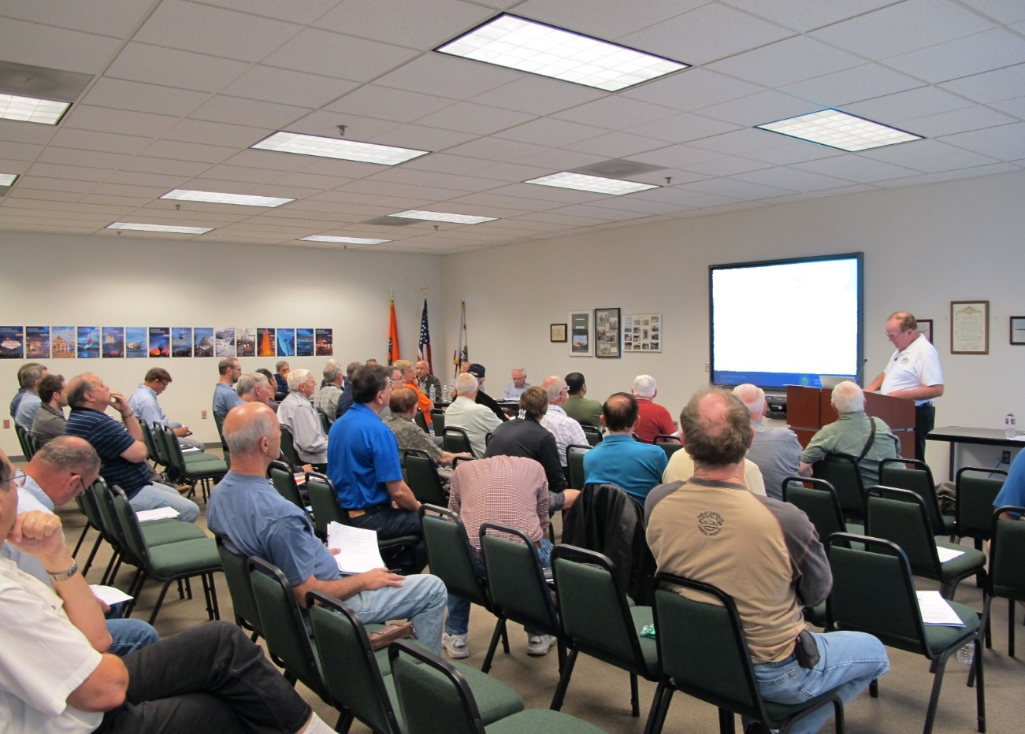
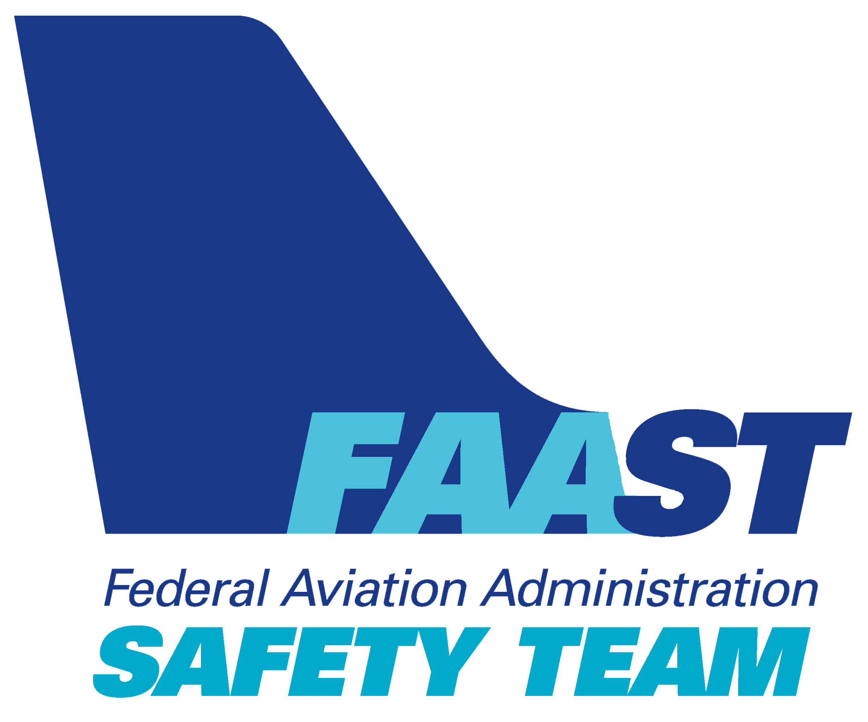
Welcome
Exits
Restrooms
Emergency Evacuation
Breaks
Phones & pagers to silent or off
Sponsor Acknowledgment
Other information
Notes:
Presentation Note: Here’s where you can discuss venue logistics, acknowledge sponsors, and deliver other information you want your audience to know in the beginning.
You can add slides after this one to fit your situation.
(Next Slide)

Slide 3
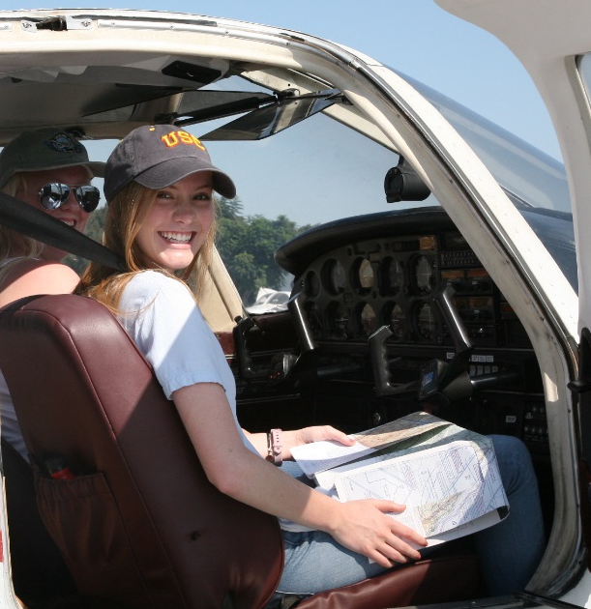
The National FAA Safety Team Presents
Foundational Elements of Safety (Review)
Notes:
We discussed Safety Risk Management in previous Topic of the Month offerings. Because we’ll need some of the information from that presentation in this one, let’s begin with a review. If you weren’t able to attend the SRM shows, don’t worry. You’ll get the idea quickly.
We’ll begin with Foundational Elements of Safety but, before we go there – let’s celebrate!
(Next Slide)

Slide 4

Let’s Celebrate!
US General Aviation has never been safer
  < 6 accidents/100,000 hours
±1 fatal accidents/100,000 hours
But …..
Accidents still happen
Notes:
United States General Aviation has never been safer. Our impressive record of fewer than six total accidents and plus or minus 1 fatal accident per 100,000 hours of GA flying is worthy of celebration. (Click)
We can do better but it isn’t going to be easy. Here’s why.
(Next Slide)

Slide 5
A system in equilibrium
Data source: US DOT Bureau of Transportation Statistics
Accident Prevention Program
Aviation Safety Program
FAASTeam
2015
2018
Notes:
In the last 50 years we’ve made impressive progress in GA accident reduction but now we find ourselves in a state of equilibrium. Dramatic reductions in the accident rate are a thing of the past and, if we keep doing everything we’ve been doing, the accident rate will stay at or very close to where it is. In order to reduce that rate we’ll have to keep on doing what we’re doing but also do something new.
(Next Slide)

Slide 6
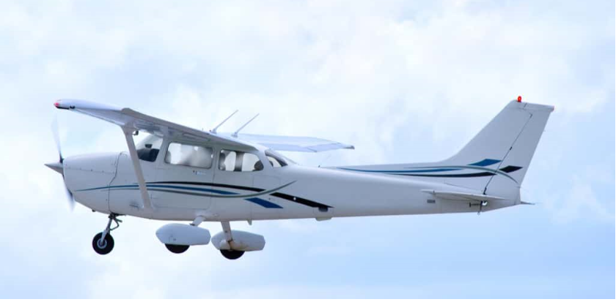
A Time of Transition
Reactive Cultures
  Wait for something to go wrong – then fix it.
    Blame, shame, retrain
    Write another procedure
Proactive “Just” Cultures
  Ask What? rather than Who?
  Identify hazards
  Assess risk (s)
  Eliminate or mitigate to acceptable
  levels
  Maintain accountability
Notes:
We are also transitioning from Reactive Cultures where we wait for something to go wrong and then fix it; to Proactive “Just” cultures. (Click)
Reactive cultures are famous for blaming, shaming, and retraining or even firing pilots who are involved in accidents and incidents. They might even look at the procedure or procedures involved and make adjustments that will hopefully prevent another occurrence. The trouble with this way of thinking is; you have to have an undesirable event before you begin to think about how to avoid it. And if you focus your attention on individuals rather than systems and environments; you’re often setting up folks for future failures.
Proactive “Just” cultures are a much better way to go. Click)
Proactive cultures ask, “what happened”, rather than, “who’s responsible and how should they be punished?”
Proactive cultures seek to:
identify hazards associated with flight operations,
assess the risk that those hazards would negatively impact safety,
and either eliminate those risks or mitigate them to acceptable levels of safety. (Click)
Proactive cultures still hold people accountable for their actions but, if they are complying with established regulations, policy, and procedure, the focus will be on fixing the system rather than fixing the individual.
(Next Slide)

Slide 7

Safety Management Systems
Safety Policy
  A Top down commitment to safety
Safety Risk Management
  Hazard Identification
  Risk Assessment
  Risk elimination or mitigation
Safety Assurance
  Feedback, best practices & process improvement
Safety Promotion
  Walking the Talk
Notes:
Proactive cultures often feature formal Safety Management Systems or SMS. A SMS consists of 4 foundational pillars. (Click)
Safety Policy – is a top down commitment to safety. In large organizations that means safety is paramount for the CEO all the way to the latest entry-level new hire. For individuals it means an unwavering commitment to safe operations.
Safety Risk Management – is a formal process that identifies potential hazards, assesses the likelihood that identified hazards will negatively compromise operations, and predict what the consequences will be should a mishap occur. SRM also identifies ways to either mitigate hazards or mitigate them to an acceptable level of safety.
Safety Assurance – monitors and feeds back results and best practices from the Safety Risk Management process. This feedback is used to refine processes and procedures.
Safety Promotion – actively and constantly demonstrates the commitment to safety. In other words Safety Promotion is walking the talk.
(Next Slide)

Slide 8

SMS for General Aviation
Safety Policy
Safety Risk Management
Safety Assurance
Safety Promotion
https://bit.ly/3iPAlsw
Notes:
FAA is bringing SMS to General Aviation. To find out more about the SMS initiative, capture the QR code or navigate to the URL on this screen.
Presentation note: Give the audience time to copy the on-screen information then:
Next, let’s revisit the three foundational elements of safety.
(Next Slide)

Slide 9
Foundational Elements of Safety
Safety Risk Management
  Hazard identification & risk mitigation
Pilot Proficiency
  The skills to do the job
Technology
  Supporting safe decision making
  and aircraft operations
Notes:
Our collective and individual safety programs are based on these foundational elements: (Click)
Safety Risk Management – hazard identification and risk mitigation,
We defined hazards, risks, and risk assessment (Click)
Pilot Proficiency – the skills to do the job,
We discussed the necessity of continuing proficiency education for pilots in the context of FAA’s WINGS Pilot Proficiency Program (Click)
and we discussed the benefits and challenges presented by emerging Aviation Technologies.
(Next Slide)

Slide 10
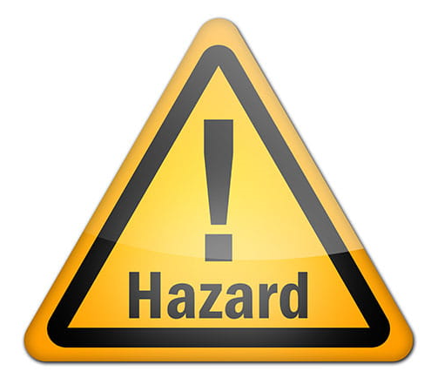

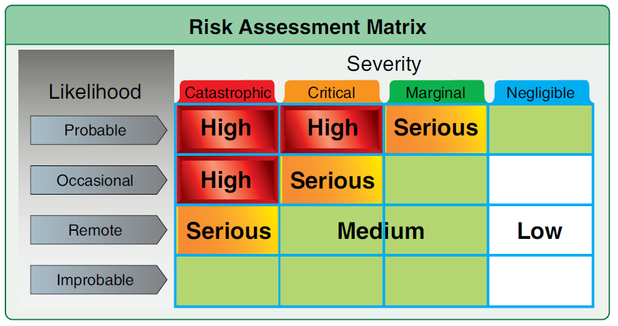
Definitions
Hazard – a condition, event, object, or circumstance that could compromise safety.
Risk – the future impact of hazards that are not eliminated or controlled.
Risk Assessment – considers the likelihood that a hazard will compromise safety and the severity of consequences if it does.
Notes:
Finally let’s just do a quick review of these definitions:
How do we define a Hazard, Risk, and Risk Assessment?
Presentation note: Give the audience time to define each term. Then click to reveal the answer: (Click)
A hazard is a condition, event, object, or circumstance that could compromise safety. The presence of thunderstorms along our route of flight would be considered a hazard. (Click)
Risk – there are actually six different types - is the future impact of hazards that are not eliminated or controlled. In other words, what are the odds that an identified risk will impact our objectives? To cite our example; flying through a thunderstorm is very likely to negatively impact our safety. (Click)
And Risk Assessment – involves determining how likely it is that an identified risk will compromise safety and the severity of consequences if it does.
(Next Slide)

Slide 11
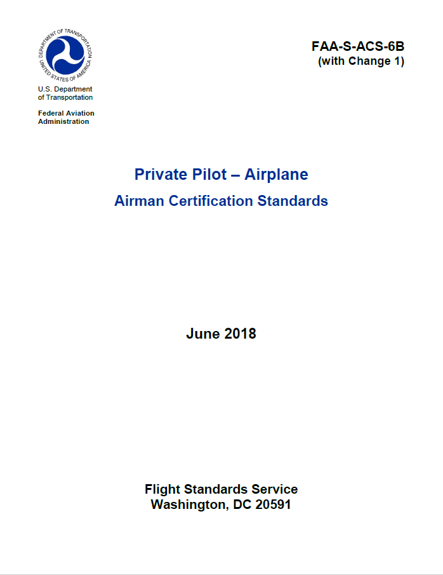
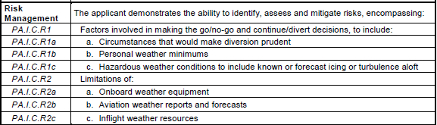
Risk Management
Notes:
Risk Management is now included in pilot certification standards so it should be familiar to all CFIs and their students. But Risk Management is only part of the human factors story. Let’s begin by acknowledging how far we’ve come in General Aviation Safety and then look at where we need to go next.
(Next Slide)

Slide 12
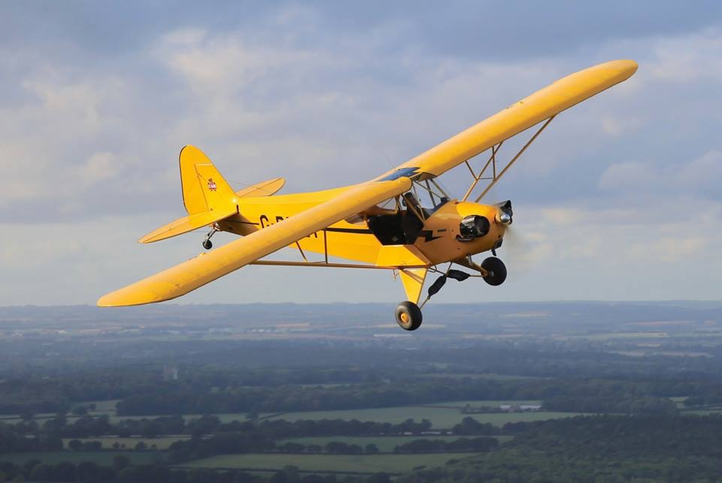
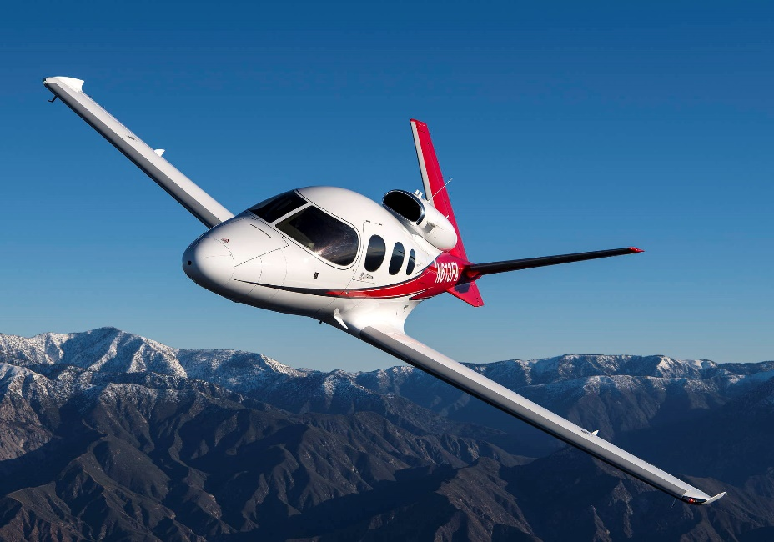
We’ve come a long way….
Notes:
We’ve come a long way in GA Safety and, if we keep doing what we’re doing, we can expect the accident rate to stay where it is. But, as we said before, we’ll have to explore some new ground if we’re going to drive the GA Accident Rate lower. We’re going to have to look at how and why humans succeed ….. and fail. We’ll have to find ways to facilitate success and ways to eliminate or reduce the risk of failure.
(Next Slide)

Slide 13

Human Factors
The Final Frontier
Notes:
So this is where we begin the next leg of our journey with an introduction to Human Factors – The Final Frontier.
(Next Slide)

Slide 14
Introduction to Human Factors
Human Factors study applies knowledge of the human body and mind in order to understand human capabilities and limitations.
HF knowledge informs human task specifications and complementary system and technology design.
Notes:
The term “human factors” refers to the wide range of issues affecting how people perform tasks in their work and leisure environments. Human factors study applies knowledge of the human body and mind to better understand human capabilities and limitations. This allows us to better design tasks, systems, and technology in order to optimize the relationship between human operators and the environments within which they work.
(Next Slide)

Slide 15

Understanding Human Factors
Better communicators
Better decision makers
Better crisis managers
Better teachers
Better students
Safer Operations!
Notes:
Understanding human factors facilitates communication. We are better able to craft messages and better able to understand them.
Decision making is much improved when human factors are taken into account.
Understanding how we function under stress and managing our responses to stressful situations makes it much more likely we’ll survive a crisis.
Human Factors-aware Flight Instructors can craft more effective instructional experiences for students.
And students who are versed in HF are better able to absorb and retain information. (Click)
That all adds up to safer, more efficient flight operations.
(Next Slide)

Slide 16
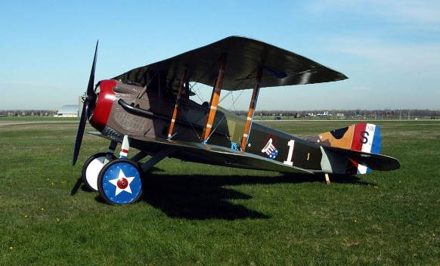
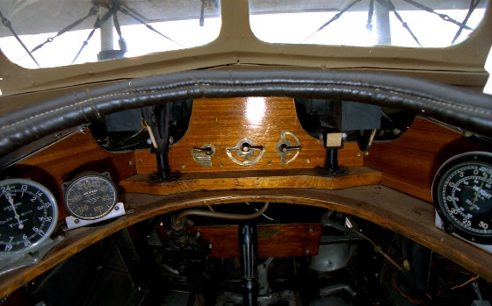
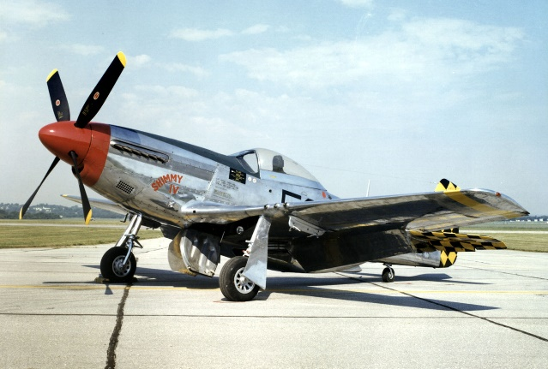
The Human Factors Challenge
Human performance deficiency contributes to 70 to 80 percent of aviation accidents.
World War I aircraft design improvements also increased complexity.
World War II aircraft evolved rapidly and pilots struggled to adapt.
Notes:
Few aviation accidents result purely from technical factors. In around 70 to 80 percent of cases, deficiencies in human performance contribute directly to the outcome. (Click)
World War I spawned improvements in aircraft design and performance. This also resulted in increased aircraft complexity. Accident experience prompted aircraft designers to consider human performance requirements. (Click)
World War II aircraft evolved rapidly and accident numbers increased as pilots struggled to adapt increased performance and to controls and displays far more complex than anything they had experienced before.
(Next Slide)

Slide 17
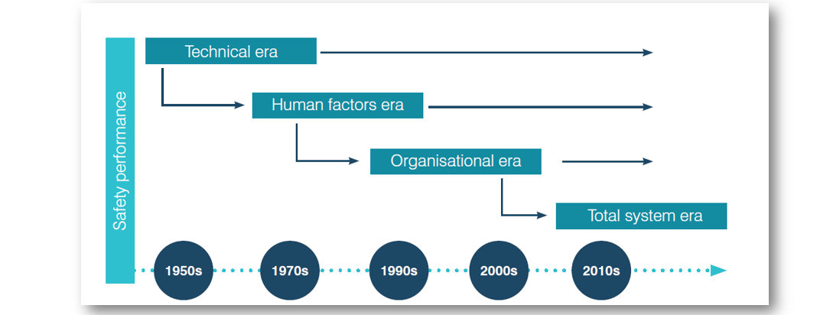
Human Factors Timeline
image reproduced from ICAO (2018) Safety Management Manual (4th Edition)
Notes:
Rapid development of aviation technology began in World War II beginning the Technical Era that continues to this day.
(Next Slide)

Slide 18
Human Factors Timeline
image reproduced from ICAO (2018) Safety Management Manual (4th Edition)
Notes:
Increased aircraft capability and complexity required a consideration of human factors. The military sector sponsored human factors research beginning in the 1940s. Then major air carrier accidents in the United States and Europe in the 1970s focused attention on Human Factors in private-sector aviation as well.
(Next Slide)

Slide 19
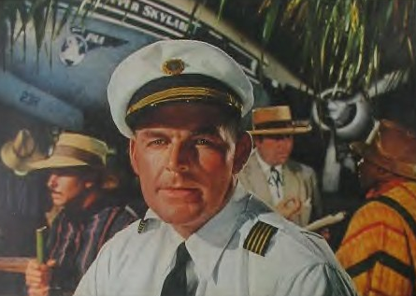
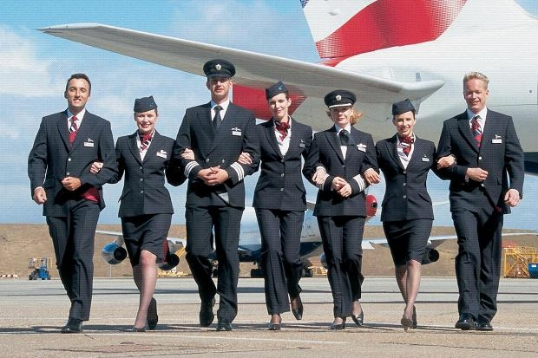
Cockpit Resource Management
Notes:
Supported by information from flight data and cockpit voice recorders; accident investigations in the 1980s and 90s identified deficiencies in crew resource management. (Click)
That discovery led to the Crew Resource Management and Single-pilot Resource Management processes that are practiced today.
(Next Slide)

Slide 20
Human Factors Timeline
Organizational era
image reproduced from ICAO (2018) Safety Management Manual (4th Edition)
Notes:
In-depth accident investigations also showed us that deficiencies at the organizational level were major contributors to crashes. Thus began the Organizational Era.
(Next Slide)

Slide 21
Human Factors Timeline
Organizational era
Organizational era
image reproduced from ICAO (2018) Safety Management Manual (4th Edition)
Notes:
At the turn of the century, studies of organizational accidents led us to the Total System Era that seeks to infuse safety attributes and safety risk management throughout our operations.
(Next Slide)

Slide 22
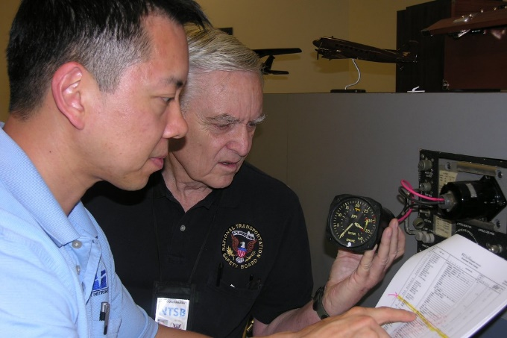

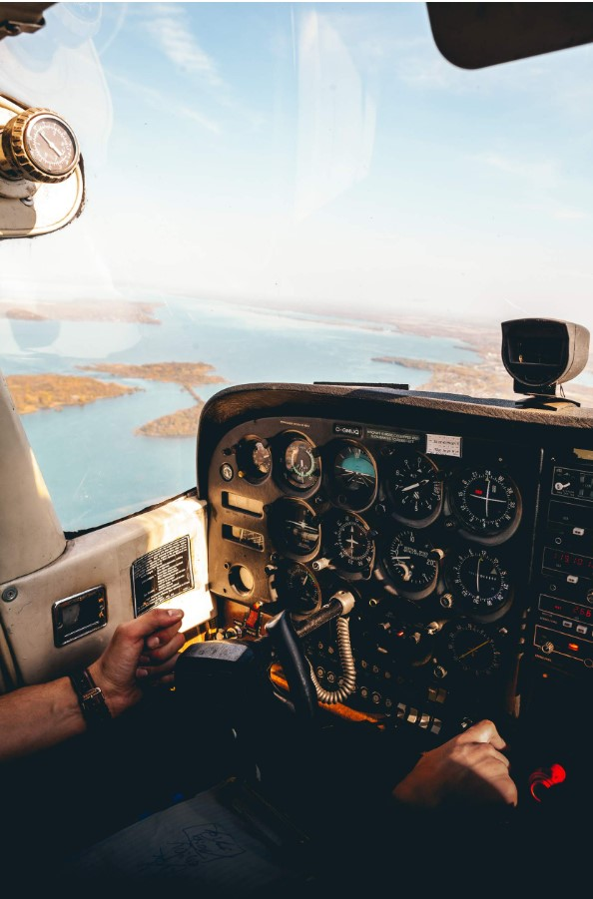
The accident chain of events.
Notes:
We’ve all heard of the accident chain – a series of circumstances, events, and decisions that leads to an accident. We are told that breaking any link in the chain can prevent the accident. (Click)
Investigators – looking from the accident backwards are often able to identify these precursory links. (Click)
But it’s much more difficult to see them when looking forward from the pilot’s point of view.
Human Factors knowledge helps us to devise technologies, policies, and processes that defend against human error. Dr. James Reason has a very good model of how this works.
(Next Slide)

Slide 23

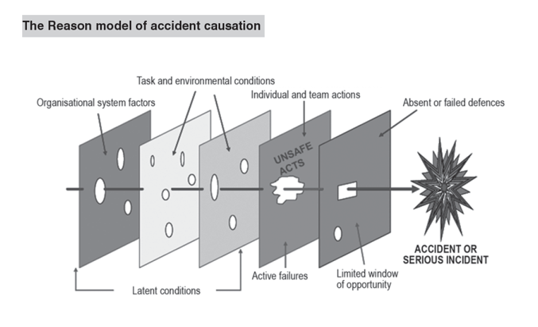
Dr. James Reason’s model of accident causation
Individual & team actions
Flying while ill, fatigued, or impaired
Continued flight into weather
Regulatory or policy violations
Organizational Factors
Training
Proficiency
Operational Policy & Procedures
Defenses
Controls and barriers to prevent incidents or limit their consequences.
Administrative - Dispatch, preflight planning, inspections
Engineered – Stall & gear warning systems
Task & Environmental Conditions
Mission & schedule, Terrain, Weather, Time of day, Pilot health, nutrition, hydration & rest
Notes:
He describes the accident chain as slices of Swiss cheese. Only when the holes align do accidents occur. Referencing his illustration, we can begin to see the systemic nature of flight operations and that perspective helps us to look for and correct inadequacies before they become links in an accident chain. Let’s take a few minutes to see how the model might apply to our operations.
Reading left to right, the first three slices represent latent conditions; that is, factors and conditions that are always present before and during flight. Latent conditions exist but they may not be obvious. They may even be concealed until, through a combination of circumstances, they are revealed. (Click)
Organizational factors would include Operational policies and procedures, regulatory requirements, training and proficiency. (Click)
Task and Environmental Conditions include, mission and schedule, weather, terrain, time of day, pilot health, nutrition, hydration and rest. (Click)
Active failures include, flying while ill, fatigued, or impaired, continued flight into adverse weather conditions, regulatory and policy violations.
And finally, we consider defenses, many of which are latent. Some may even be built into the aircraft. (Click)
Defenses include, controls and barriers to prevent accidents or limit their consequences, dispatch, preflight planning, and inspections and engineered defenses such as stall and gear warning systems and automation. Many of these are also latent conditions. In fact, some may be built into the airplane. What might fall into this category?
The illustration helps us to understand that accident precursors can be present on any flight but defenses and proper individual and team actions can prevent them from leading to a disaster.
(Next Slide)

Slide 24
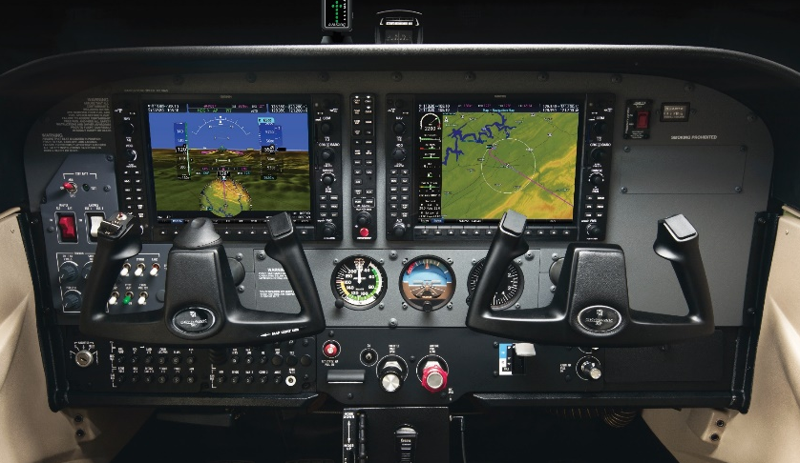
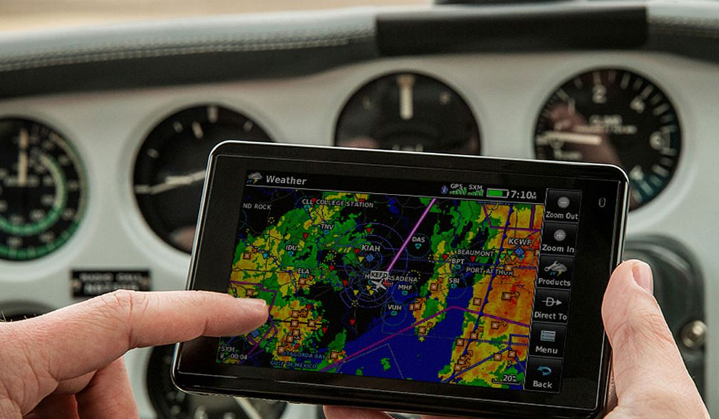
Understanding Human Factors
Knowing when and where mistakes are likely to be made
Understanding the system component of error
Error-tolerant systems
  Checks and balances
  Complementary and assistive technology
Notes:
Today, the human factors challenge continues with ever more complex aircraft, automation, and tasking. Errors are present in every human activity. Many, if not most, errors have little impact on our objectives but some result in disastrous consequences. (Click)
Knowing when and where humans are likely to make mistakes has helped us to understand that errors rarely occur in a vacuum but rather within organizational and operational systems. (Click)
That allows us to design safety management systems that feature error-tolerant processes with built in checks and balances and complementary assistive technology.
(Next Slide)

Slide 25

Challenges
Over-reliance on automation
Pilot shortages
Terrorism
Drones
Notes:
Interestingly, that assistive - often automated - technology has caused an over-reliance on its’ availability. Pilots who rely too heavily on automation tend to mistrust their abilities. Indeed, hand flying skills diminish rapidly when they are not exercised regularly, thus promoting even more reliance on automation.
Pilot shortages have strained existing operations that are pressured to do more with less and to accelerate their training programs in order to meet the demand.
The world wide increase in terrorism puts additional pressure on safety and security systems as does the increased collision hazard posed by drones.
How effectively we collectively and individually deal with these and other challenges has a lot to do with our shared beliefs, attitudes, norms, and values. There’s a name for that. Does anyone know what it is?
Presentation note: Solicit answers from audience. Then:
(Next Slide)

Slide 26

Safety Culture
Beliefs
Attitudes
Norms
Values
Notes:
The beliefs, attitudes, norms and values that people within an organization share are described as Organizational Culture. You could describe culture as, “the way we do things around here”.
Safety Culture is an essential part of organizational culture. It affects the way the organization manages safety and therefore, the ultimate effectiveness of its safety management system.
(Next Slide)

Slide 27
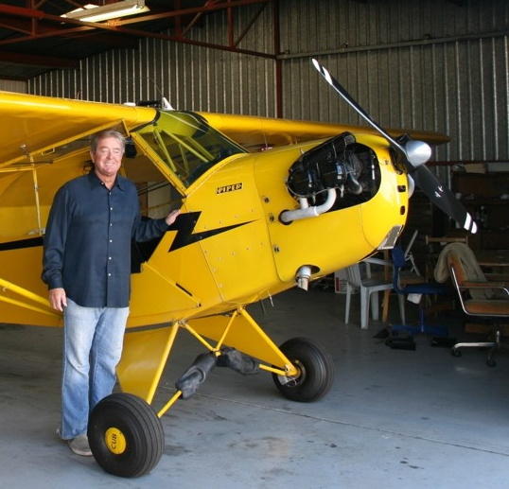
But I’m just one pilot….
“I don’t fly for an airline and I don’t belong to a club. I don’t have an organizational culture that influences my operational decisions.”
Notes:
Some of us may feel, as this pilot does, that they aren’t subject to cultural influences – especially when they are flying.
Well, like it or not, we are all exponents of multiple cultures and subject to common cultural influences. Even attendance at this program is likely driven by belief in the efficacy of safety cultures. Membership in The FAASTeam is another choice driven by culture as is meeting a group of pilots for lunch at the airport café.
(Next Slide)

Slide 28

Culture is a really big deal
Defines group
  identity
  work and safety ethics
Rules
  may be unwritten or well documented
  are very powerful
  usually reward production
  must be balanced with protection (safety)
Notes:
Culture is a really big deal and very much worth our consideration. Culture defines a group’s work and safety ethics and even group identity.
Cultural rules may be reflected in documented policy and procedures or they may be unwritten. But either way they are very powerful. Remember culture is comprised of our beliefs, attitudes, norms and values.
Successful companies value production and profit and they reward workers who meet or exceed production goals. But if profit and production are not balanced with protection (safety) bad outcomes may be expected.
We and our aviation associates create local cultures that may be very safety conscious or more willing to accept risk. Either way it behooves us to commit to safe decisions and actions.
(Next Slide)

Slide 29

Production vs Protection
Established process
+ uninformed ad hoc process improvement
Disastrous result
Notes:
Sometimes cultures that value production can unintentionally compromise safety. Three workers in a facility that prepared fuel for use in experimental nuclear reactors were provided detailed instructions for producing very small amounts of material. (Click)
They reasoned that time and labor could be saved by mixing more material per batch. Although well meaning and industrious, the workers didn’t know that mixing larger amounts of radioactive materials could precipitate an uncontrollable atomic reaction. (Click)
The uncontained nuclear reaction contaminated the facility and fatally injured two of the workers.
(Next Slide)

Slide 30
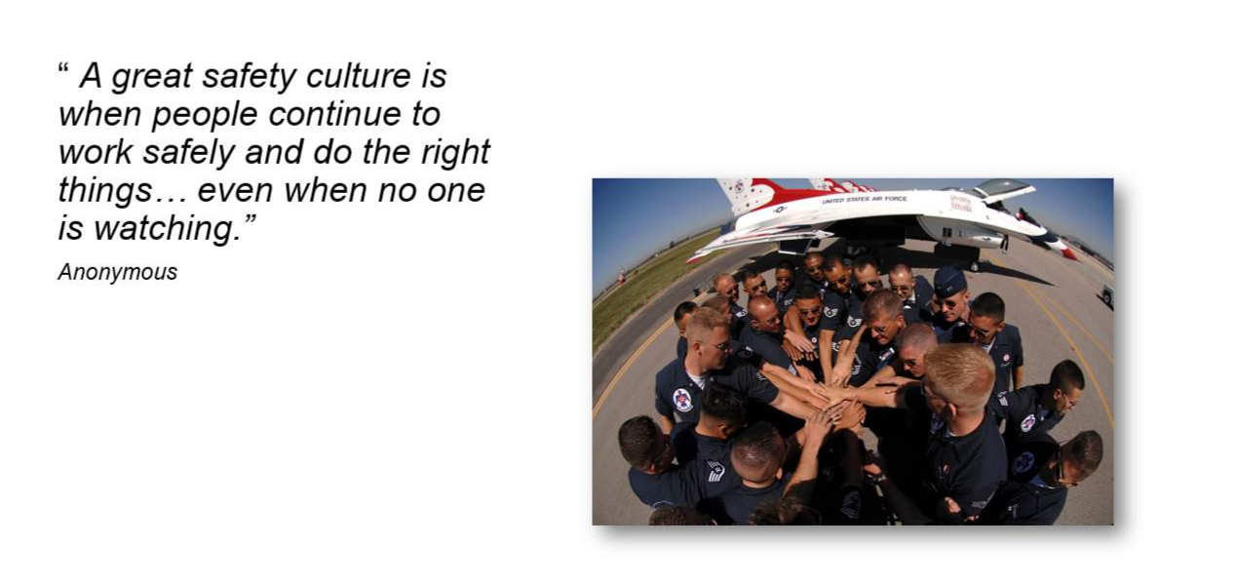
Notes:
This is a good definition of a well developed safety culture and an opportunity to visit the enabling nature of safety. Robust safety management programs employed through a team of dedicated, proficient people can enable organizations to perform incredibly difficult and dangerous tasks in safety.
Military demonstration teams are able to perform thousands of flight demonstrations without mishap not because they are lucky; but because every member of the team from the commanding officer to the newest member is an active member of the organizational safety culture.
Dr. Reason also produced a model of the five key ingredients of effective safety cultures. Let’s see what he has to say about them.
(Next Slide)

Slide 31
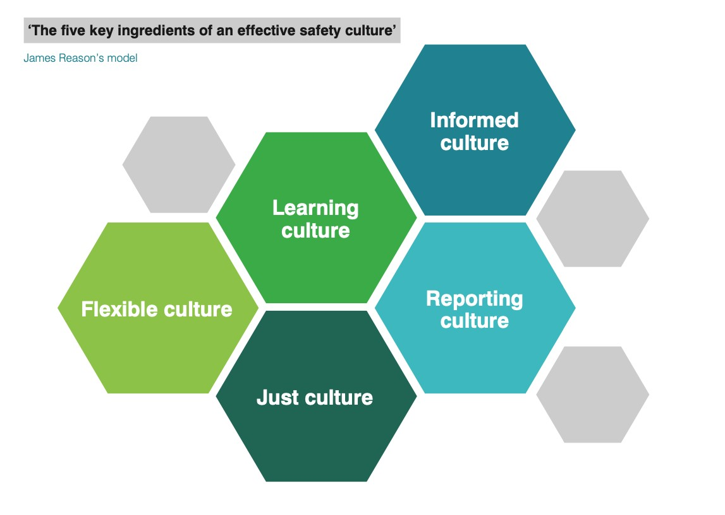
Learning Cultures
Are constantly evolving and improving in response to safety information gleaned from operations monitoring and robust reporting cultures.
Informed Cultures
Collect and act upon current knowledge about the human, technical, organizational, and environmental factors influencing the safety of the system.
Flexible Cultures
Encourage effective relationships that support mission objectives. They are often organized as groups of professionals working together to achieve common goals rather than hierarches of managers and employees.
Reporting Cultures
Reward reporting and discussion of errors and best practices. They use information discovered in the reporting process to improve safety processes and procedures.
Just Cultures
Foster an atmosphere of trust by encouraging and rewarding the disclosure of safety information while maintaining accountability and a clear distinction between acceptable and unacceptable behavior.
Notes:
Presentation note: click on each element to reveal detail for that ingredient.
Informed Cultures – collect and act upon current knowledge about the human, technical, organizational, and environmental factors influencing the safety of the system.
Reporting Cultures – reward reporting and discussion of errors and best practices. They use information discovered in the reporting process to improve safety processes and procedures.
Learning Cultures – Are constantly evolving and improving in response to safety information gleaned from operations monitoring and robust reporting cultures.
Flexible Cultures – Encourage effective relationships that support mission objectives. They are often organized as groups of professionals working together to achieve common goals rather than hierarches of managers and employees.
Just Cultures - Foster an atmosphere of trust by encouraging and rewarding the disclosure of safety information while maintaining accountability and a clear distinction between acceptable and unacceptable behavior.
When each ingredient has been revealed:
(Next Slide)

Slide 32
Learning Pilots …
Are constantly evolving and improving in response to safety information gleaned from operations monitoring and robust reporting cultures.
Informed Pilots …
gather all available information before flight and identify hazards that may compromise safety. They eliminate or mitigate the risks those hazards pose before takeoff and continuously update their assessments with new information en route.
Flexible Pilots …
are flexible in their relationships and in their mission planning and execution. The are willing to adapt to changing conditions and priorities but only if they can maintain an equivalent or higher level of safety.
Reporting Culture Pilots …
do not hesitate to discuss and learn from errors they make. They strive to report objectively and without bias. They seek guidance and coaching from flight instructors and peers.
Just Culture Pilots …
understand that errors are inevitable and that they have a responsibility to disclose them in order to provide information useful to crafting more effective processes and procedures.
expect to be treated fairly but also to be held accountable for their actions - especially those that are violations of policy, procedure, or regulation.
Notes:
Now let’s discuss what attributes individual pilots might exhibit in support of each ingredient. What are some attributes of Informed Pilots?
Presentation note: As each ingredient is discussed, click to reveal detail for that ingredient. When each ingredient has been revealed:
Informed Pilots - gather all available information before flight and identify hazards that may compromise safety. They eliminate or mitigate the risks those hazards pose before takeoff and continuously update their assessments with new information en route.
Reporting Pilots - do not hesitate to discuss and learn from errors they make. They strive to report objectively and without bias. They seek guidance and coaching from flight instructors and peers.
Learning Pilots - are constantly learning from their experiences and from those of their peers. They participate in continuing education and proficiency training and they use lessons learned to improve their operational procedures.
Flexible Pilots - are flexible in their relationships and in their mission planning and execution. The are willing to adapt to changing conditions and priorities but only if they can maintain an equivalent or higher level of safety.
Just Culture Pilots - understand that errors are inevitable and that they have a responsibility to disclose them in order to provide information useful to crafting more effective processes and procedures. They expect to be treated fairly but also to be held accountable for their actions – especially those that are violations of policy, procedure, or regulation.
When discussion is complete:
(Next Slide)

Slide 33

Where did it go wrong?
Notes:
Returning to our story of the unintended nuclear reaction:
We could say that the culture was flexible in that it supported the ad hoc process improvement idea. What cultural ingredient or ingredients from Dr. Reason’s recipe could have prevented the disaster?
Presentation note: Lead a discussion on the question above.
If the workers were informed as to why the process yielded small batches, they would not have attempted the ad hoc process improvement. A culture that supports learning will certainly take this incident to heart especially if the reporting is comprehensive and correct. A just culture would likely conclude that the company did not provide sufficient information to the workers as to why the process was intended to yield small batches only. Learning from the disaster would likely result in a more robust hazard identification and risk analysis process that would address future risks before they become disasters.
When discussion is complete:
(Next Slide)

Slide 34

What about our culture?
Notes:
Finally – let’s talk a little bit about our local culture. What common values does our aviation community hold? Who do we emulate and why?
Presentation note: Lead a discussion on the topic above.
Ask attendees to describe their local safety communities, and what’s being done to foster robust safety cultures within them.
Address the fact that, “actions speak louder than words”. Pilots and Flight Instructors must constantly walk the talk and set the example with safety always a prime consideration. If we speak safety and our actions show otherwise, we’ve lost our credibility.
When discussion is complete:
(Next Slide)

Slide 35
Human factors is huge!
Notes:
Well I think you’ll agree that human factors is a huge subject area and we’ve just scratched the surface in this Program. We hope we’ve provided a few things you can use right away and that you’ll be motivated to learn more. Here’s our recommendation for further investigation.
(Next Slide)

Slide 36




https://tinyurl.com/4mcvzjsw
Notes:
The Australian Civil Aviation Safety Authority has authored an excellent online Human Factors training program. They have generously offered to share the program with us and we’ve used it as the basis for ten online courses hosted on FAASafety.gov. We encourage you to take advantage of this tremendous educational opportunity.
You can access the first two course modules by navigating to the URL or scanning the QR Code on screen.
Presentation note: Allow time for audience to copy screen information then:
(Next Slide)

Slide 37

Questions?
Notes:
Presentation Note: You may wish to provide your contact information and main FSDO phone number here. You can also add WINGSPro contact information.
Modify with your information or leave blank.
(Next Slide)

Slide 38
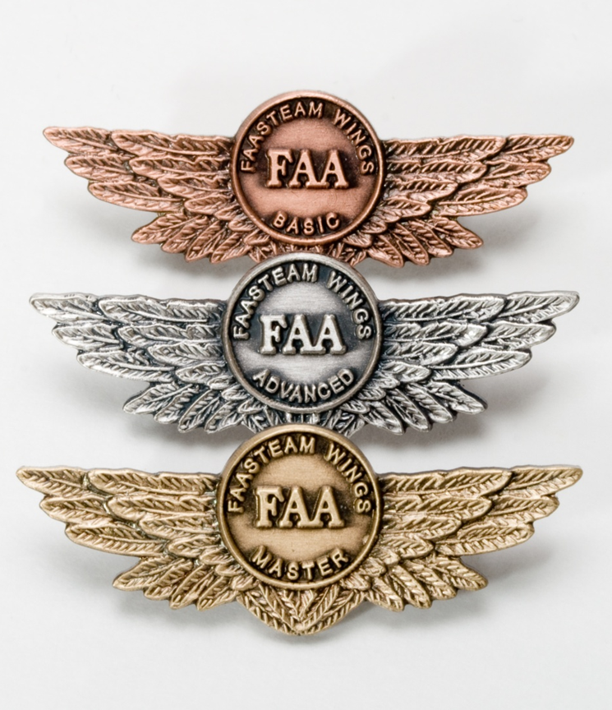
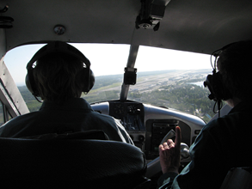
Proficiency and Peace of Mind
Fly regularly with your CFI
Perfect Practice
Document in WINGS
Notes:
There’s nothing like the feeling you get when you know you’re playing your A game and in order to do that you need a good coach (Click)
Proficient Pilots fly regularly with CFIs who will challenge them to review what they know, explore new horizons, and to always do their best. Of course they must dedicate time and money to their proficiency program but it’s well worth it for the peace of mind that comes with confidence. (Click)
Vince Lombardi, the famous football coach said, “Practice does not make perfect. Only perfect practice makes perfect.” For pilots that means
flying with precision. On course, on altitude, on speed all the time. (Click)
Encourage your flight training clients to document their achievements in the Wings Proficiency Program. It’s a great way to stay on top of their game and keep their flight review current.
(Next Slide)

Slide 39
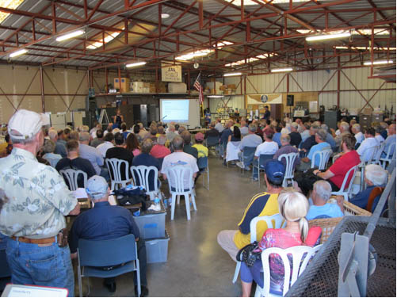
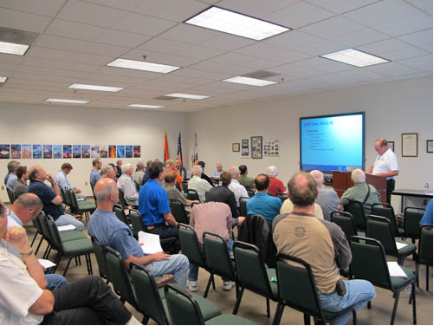
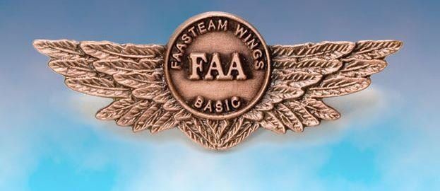
Thank you for attending
You are vital members of our GA safety community
Notes:
Your presence here shows that you are vital members of our General Aviation Safety Community. The high standards you keep and the examples you set are a great credit to you and to GA.
Thank you for attending.
(Next Slide)

Slide 40
The National FAA Safety Team Presents
Topic of the Month – January Introduction to Human Factors and Safety Culture
Notes:
(The End)

