Slide 1
The National FAA Safety Team Presents
Topic of the Month – March
Pilot Proficiency and E-Z WINGS
Notes:
2022/12-07-272(I)PP Original Author: John Steuernagle 03/17/2021; POC Kevin Clover National FAASTeam Program Mgr. (Operations), Office (562-888-2020 revised by John Steuernagle (04/28/2023)
Presentation Note: This is the title slide for Pilot Proficiency and WINGS
Script - We have included a script of suggested dialog with most slides. The script will always appear in a non-italic font. Presenters may read the script or modify it to suit their own presentation style. See template slides 5 and 6 for examples of a slides with script.
Presentation Instructions - (stage direction and presentation suggestions) will be preceded by a Bold header: the instructions themselves will be in Italic fonts. See slides 2, for an example of slides with Presentation Instructions only.
Program control instructions - will be in bold fonts and look like this: (Click) for building information within a slide; or this: (Next Slide) for slide advance.
Background information - Some slides may contain background information that supports the concepts presented in the program.
Background information will always appear last and will be preceded by a bold Background: identification.
The production team hope you and your audience will enjoy the show. Break a leg!
(Next Slide)

Slide 2
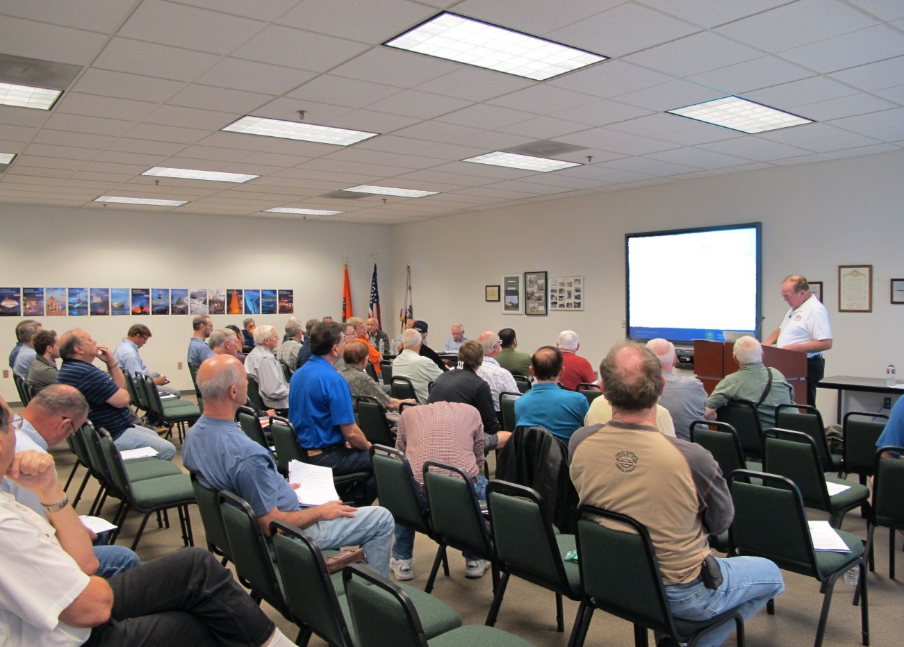

Welcome
Exits
Restrooms
Emergency Evacuation
Breaks
Phones & pagers to silent or off
Sponsor Acknowledgment
Other information
Notes:
Presentation Note: Here’s where you can discuss venue logistics, acknowledge sponsors, and deliver other information you want your audience to know in the beginning.
You can add slides after this one to fit your situation.
(Next Slide)

Slide 3
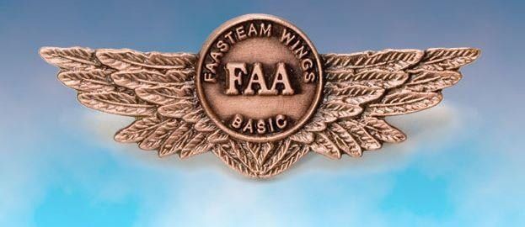
Overview
Top 5 reasons to be a WINGS Pilot
E-Z WINGS
WINGS Topic of the Quarter
Notes:
Today’s presentation is all about WINGS – FAA’s Pilot Proficiency Program. We’ll begin with the top 5 reasons to be a WINGS Pilot
Next we’ll show how easy it is to get started on your personal Path to Proficiency.
And we’ll talk about the WINGS Topic of the Quarter Program.
So let’s get started with reason number five.
Presentation Note: If you’ll be discussing additional items, add them to this list.
(Next Slide)

Slide 4
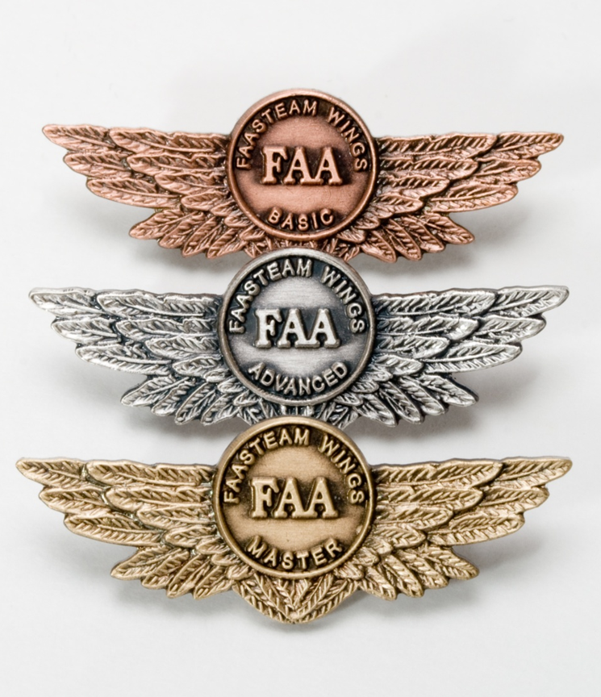
5. WINGS training yields awards
WINGS recognition
  GA Safety Community
  WINGS logbook
  WINGS pin
WINGS rewards
  WINGS insurance discounts
  WINGS merch
Notes:
Documented WINGS proficiency training earns awards. To be clear – we don’t choose proficiency training because it’s easy or because we’re looking for bling but it is nice to be recognized for our achievements. As a WINGS pilot you are recognized as a member in good standing of the General Aviation Safety Community. All of your WINGS training is permanently recorded in your online WINGS logbook and when you earn a WINGS phase you can receive a lapel pin. (Click)
Aircraft insurance carriers recognize the value of regular Proficiency Training and they may offer premium discounts to WINGS pilots. And WINGS Pilots who earn a phase and their Instructors can win pilot products from the WINGS Industry Network.
(Next Slide)

Slide 5

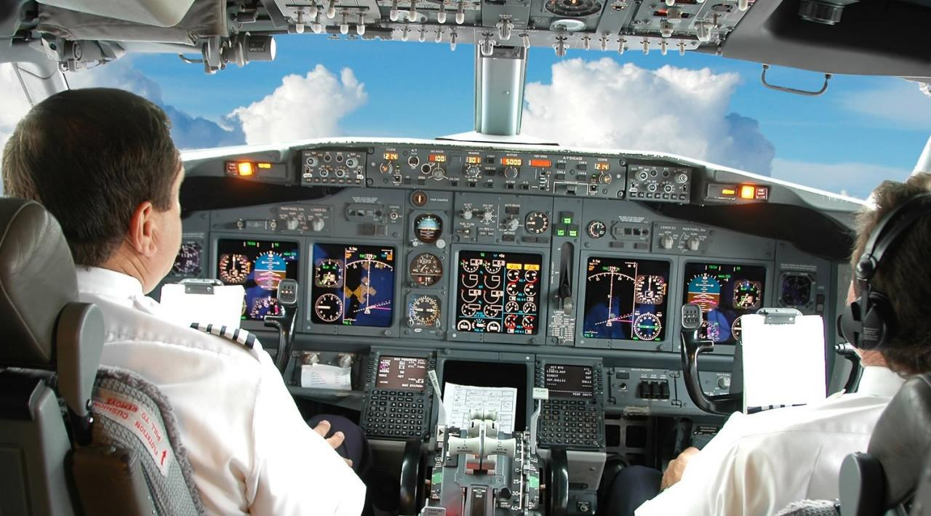


4. Proficiency training works!
Sports
Medicine
Aviation
Notes:
Reason number four – proficiency training works!
Can you imagine how well professional athletes would perform if they didn’t practice between games or stay in shape during the off season? (Click)
Would you choose to be treated by doctors who had no continuing education since graduating from medical school? (Click)
Or how about a professional pilot flight crew who never train for emergencies?
(Next Slide)

Slide 6


The Path to Proficiency
The path to proficiency doesn’t end with a check-ride. It continues throughout your flying career.
Notes:
Pros know that proficiency is not a destination but rather a journey that never ends. Regular training keeps them at peak performance every time they take to the air.
Pilots who follow the Path to Proficiency are well aware of their capabilities and their limitations. They dedicate time and resources to training and practice. And they understand that continuing education through Proficiency Training is essential to keeping them on top of their game.
(Next Slide)

Slide 7

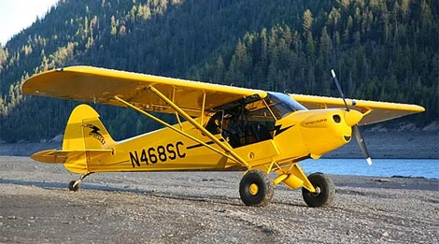
Proficiency training works for GA!
Increases confidence
Increases comfort
Keeps us safe
Earning any WINGS phase qualifies for a Flight Review!
Notes:
Proficiency training works for General Aviation pilots too. WINGS is a proficiency training system specifically designed for general aviation pilots and, regular participation will keep you on top of your flying game. Pilots who participate in the FAA WINGS Pilot Proficiency program fly with more confidence. They and their passengers are comfortable in the air.
Most importantly - proficiency training keeps us safe. (Click)
And pilots who earn WINGS phases also qualify for a flight review.
(Next Slide)

Slide 8
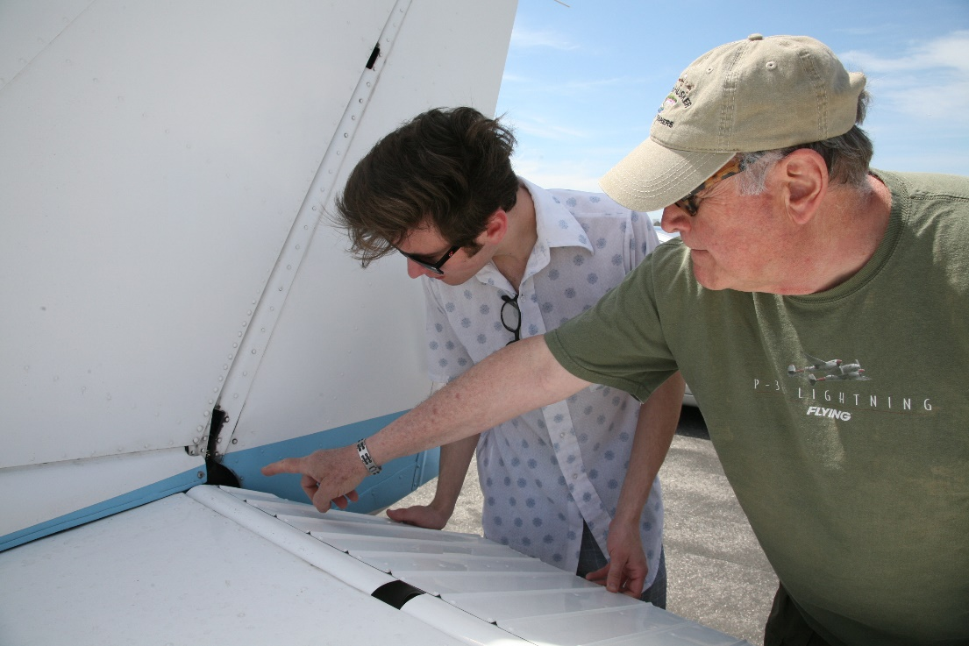
3. WINGS coaching gets results!
WINGS CFIs are:
  Expert in the airplane
  Familiar with the environment
    Keen observers
    Teachers
    Motivators
Develop your Personal Minimums
  Conditions for safe flight
    Keyed to individual performance
    Document and periodically review
Notes:
Reason number three – WINGS coaching gets results! Every profession relies on coaching to keep practitioners sharp. All Flight Instructors are trained in performance evaluation and critique and most make great coaches. WINGS Instructors are expert in your aircraft and the training environment. They are keen observers and teachers who will push you to excellence in flying. (Click)
Together you and your WINGS CFI can develop your Personal Minimums – A set of conditions, procedures, rules, criteria, and guidelines that help pilots to decide when it’s safe to fly. As the name implies, your Personal Minimums are unique to you and keyed to your demonstrated ability. In consultation with your coach, you’ll develop and document your personal minimums based on your individual performance. Pilot performance levels are not constant. They change over time and WINGS pilot performance continues to improve. WINGS training gives you regular opportunities to review and update your pilot performance profile and personal minimums but you need a reference point to start.
(Next Slide)

Slide 9
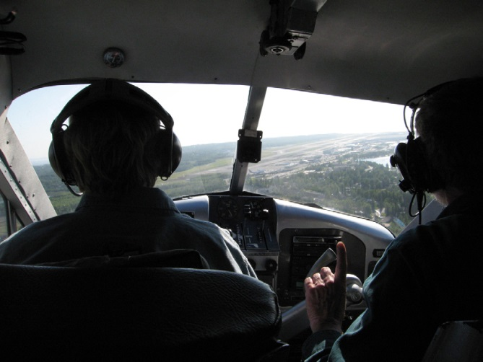
What’s your personal performance baseline?
Aircraft
  Mission weight
  Maximum wind experienced
    In aircraft type
Airfield
  Typical for mission
  Seek local knowledge
Notes:
In order to establish personal minimums you need to have a baseline – think of it as your personal, documented, demonstration of performance. We suggest you document your performance at least once a year with a WINGS CFI. Try to pick a day when you can experience actual cross-wind conditions in the airplane you usually fly and loaded to your typical mission weight. Select an airfield that’s typical for the missions you fly. If you’re planning trips to a short, obstructed runway; try to find something similar to train on. Gather information about the destination airfield from pilots who’ve flown there and share that information with your instructor. That will help your CFI to construct realistic scenarios for you to fly.
(Next Slide)

Slide 10
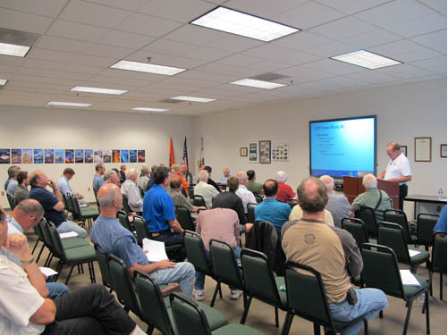
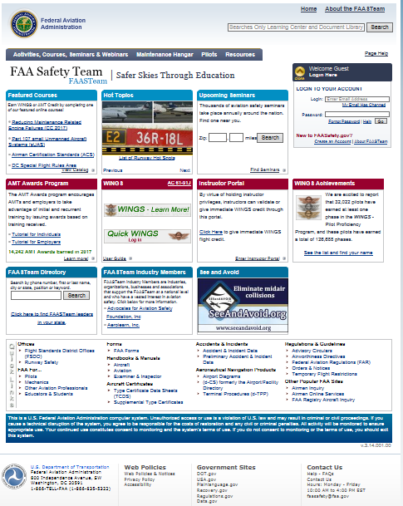
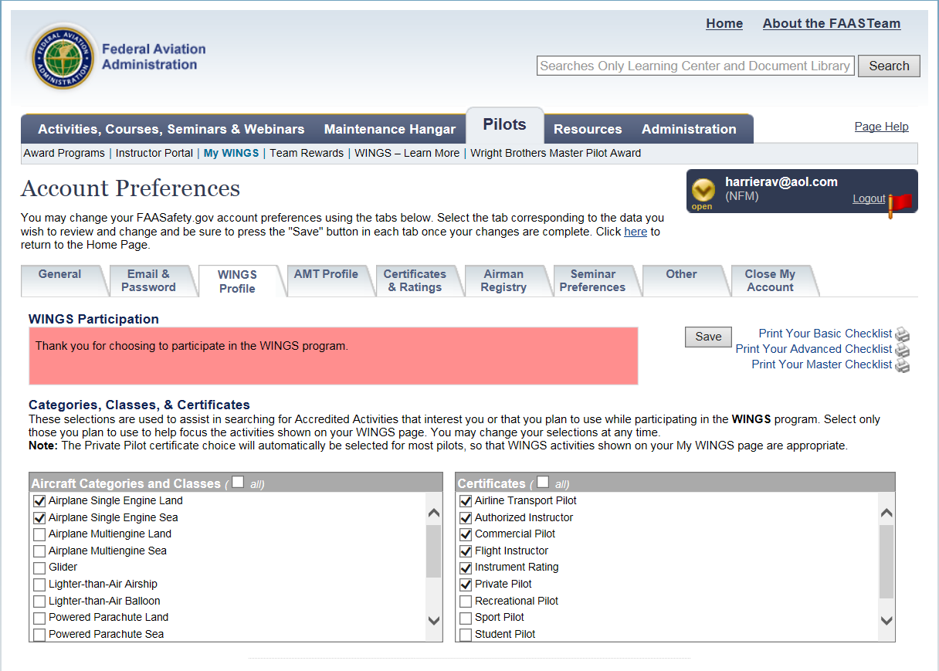
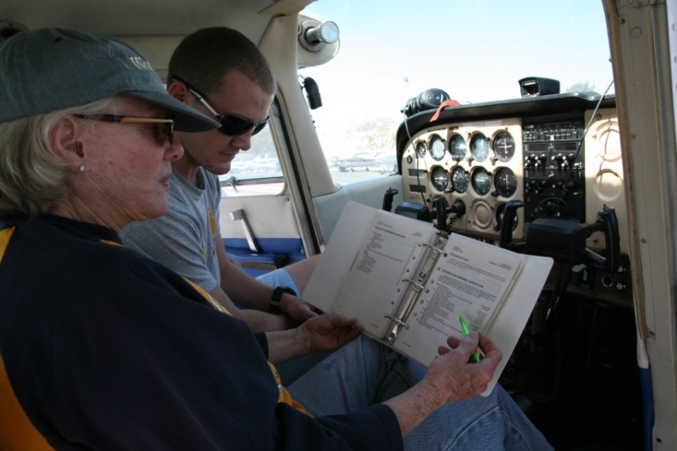
3. WINGS – easy as 1, 2, 3
Create an account on http://faasafety.gov
Complete your WINGS Pilot Profile
Attend a WINGS seminar or take a WINGS flight
Notes:
Reason number 3 - Getting started in WINGS is as easy as one, two, three.
Create an account on faasafety.gov
Complete your WINGS Pilot Profile
Attend a WINGS seminar or take a WINGS flight with your CFI.
(Next Slide)

Slide 11
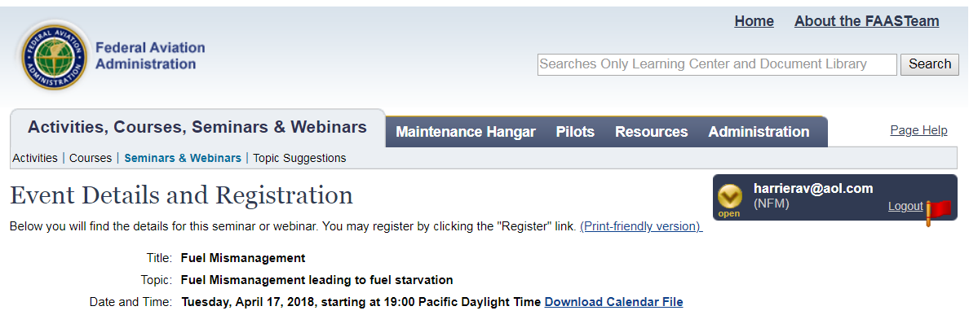
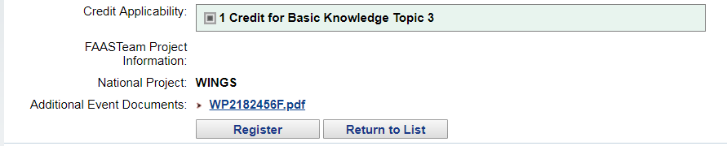
Register for knowledge credits
Notes:
For seminars and webinars you can pre-register for credit on FAASafety.gov or, in the case of live seminars, you can register via the sign-in sheet at the seminar door.
(Next Slide)

Slide 12
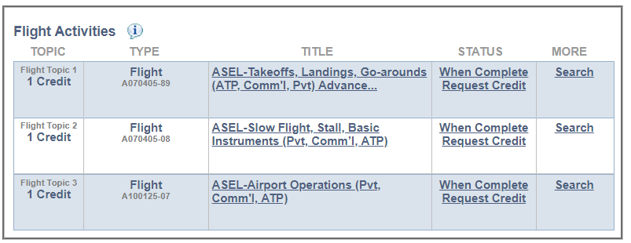
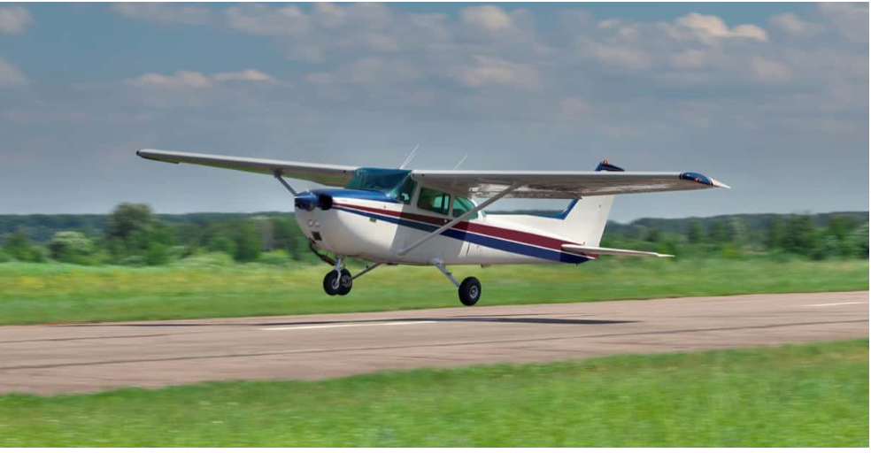
Request flight credits
Notes:
You’ll need to request credit for each flight activity with your CFI. It’s easy to do. Just go to your “My Wings” page and click on request credit after the activity has been completed. It’s really easy once you know how but now there’s an even easier way to request WINGS credit.
(Next Slide)

Slide 13
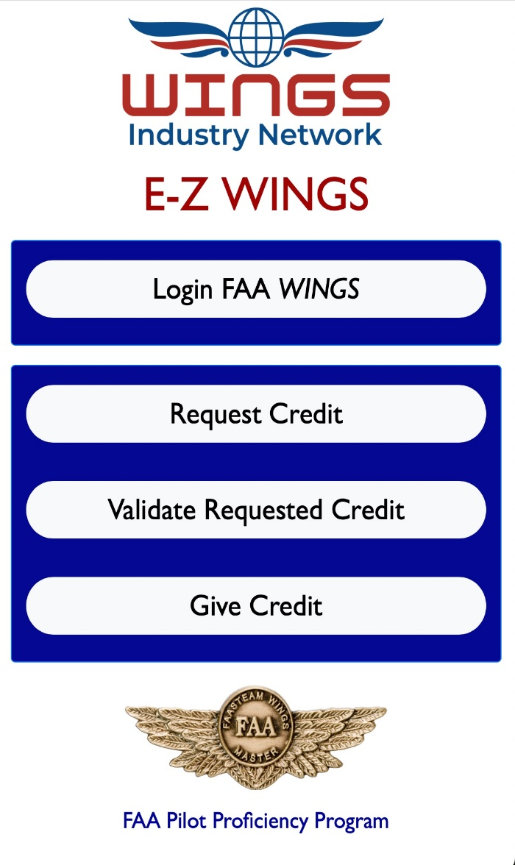
Welcome to E-Z WINGS
E-Z WINGS provides access to FAA
accredited activities to earn a WINGS Phase for:
ALL Check-rides
ALL Flight Reviews and IPCs
ALL Categories and Classes of Aircraft
Now Including Students
And Organization Specific Activities
Notes:
E_Z WINGS is a web application that makes it easy for pilots to request and receive credit for:
All Practical Tests,
All Flight Reviews and IPCs,
In All categories and classes of aircraft,
And for organization-specific activities.
And E-Z WINGS works for all pilots and student pilots.
(Next Slide)

Slide 14
What we’ll cover
Access to E-Z WINGS
FAA WINGS Login
Request Credit
Validate Requested Credit
Give Credit
Organization Specific Activities
Note:
Knowledge of the WINGS process is a prerequisite to understanding the value of
E-Z WINGS
We highly recommend accessing E-Z WINGS on a separate mobile device while reviewing this tutorial.
So, grab your smartphone or tablet, and let’s get started!
Notes:
Here’s the list of what we’ll cover in the next few minutes. We encourage you to access E-Z WINGS on your smart phone or tablet as we go along. So get your smart phone or tablet out & we’ll get started.
(Next Slide)

Slide 15
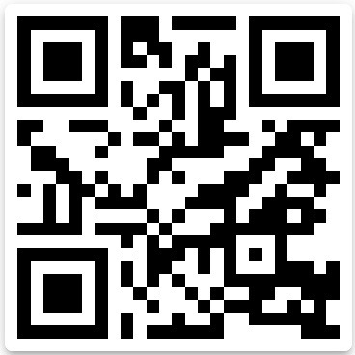
Access E-Z WINGS
Scan this QR Code to access
E-Z WINGS on your mobile device
Or visit https://www.ezwings.net
Notes:
Scan the QR code or navigate to the URL on screen.
Presentation note: Give the audience time to access e-z wings then:
(Next Slide)

Slide 16
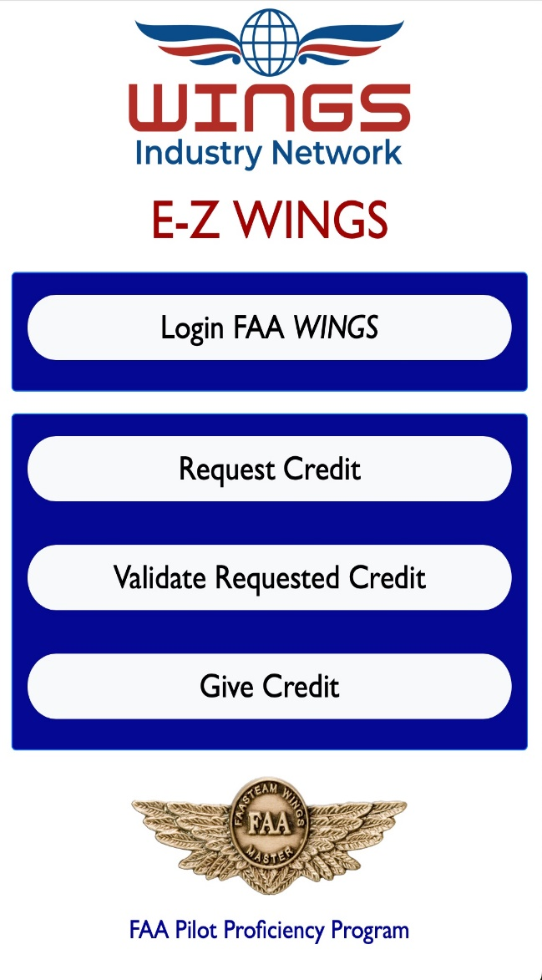
Login to the FAA Safety Website
E-Z WINGS is a web-based tool for easy access to a full set of accredited activities to request and validate a Phase of WINGS
E-Z WINGS Version 1.0 requires logging in to faasafety.gov
Logging in first makes it easier to continue through the selection process
Notes:
E-Z WINGS works together with FAASafety.gov to access a set of common WINGS activities with just a few clicks. Once you see the application on your device click on Login FAA WINGS.
(Next Slide)

Slide 17
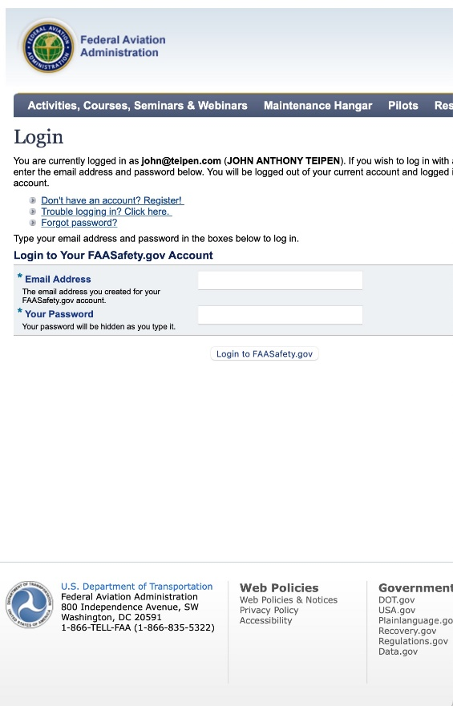
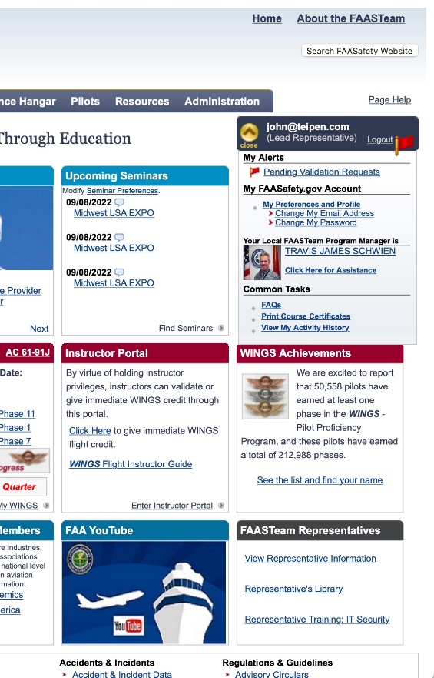
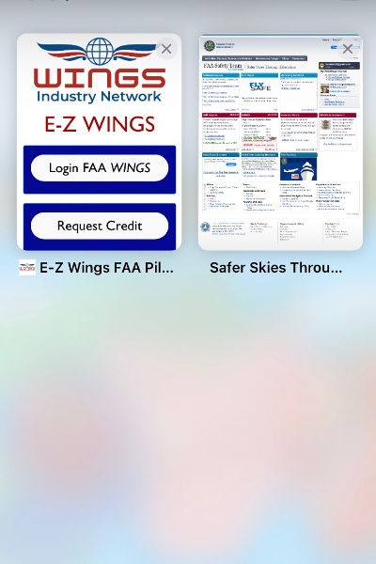
Login Here – Bypass Home Page
Check open windows to return to E-Z WINGS
Your login confirmed
Notes:
Clicking Login will bypass the FAASafety.gov home page and bring you directly to the login screen.
Once you’ve successfully logged in, return to E-Z WINGS to request credit.
(Next Slide)

Slide 18

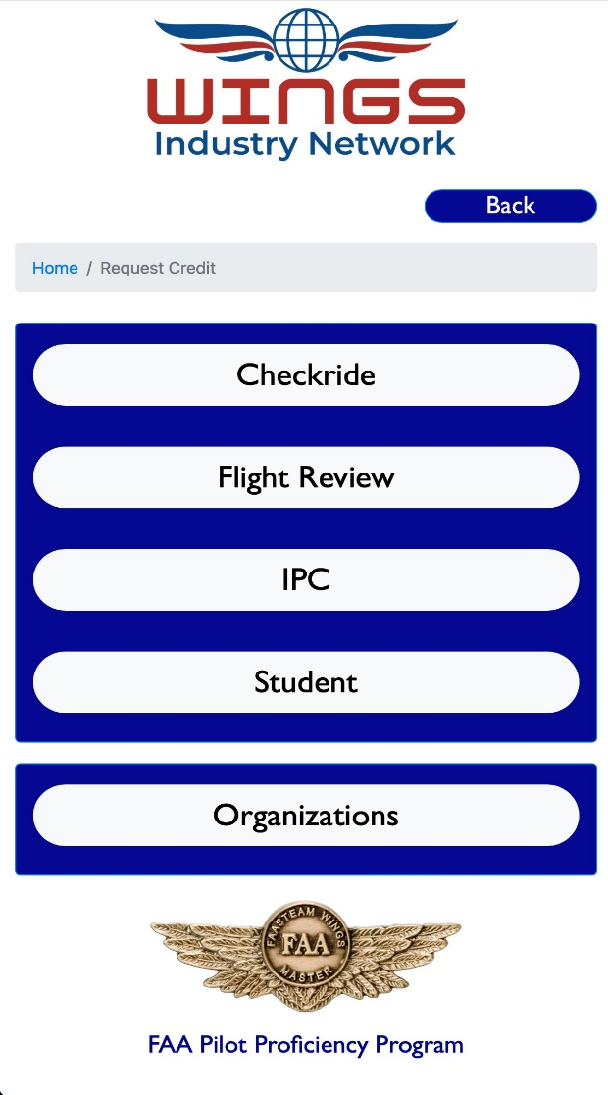
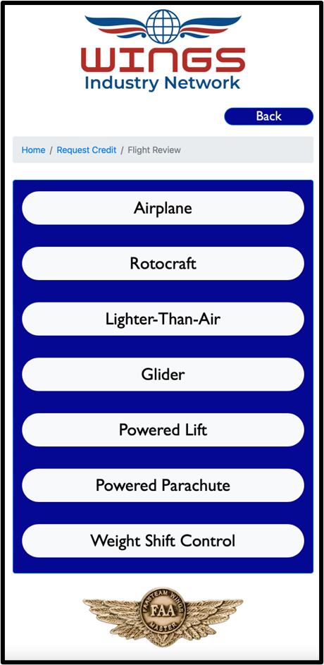
Request Credit
Select Request Credit
Select Event
Select Category
Notes:
After you request credit you’ll need to select an event.
Currently we offer Practical test or Check ride, Flight Review, Instrument Proficiency Check, Student Pilot, and selected organizational events.
Next select the applicable aircraft category from the list.
(Next Slide)

Slide 19
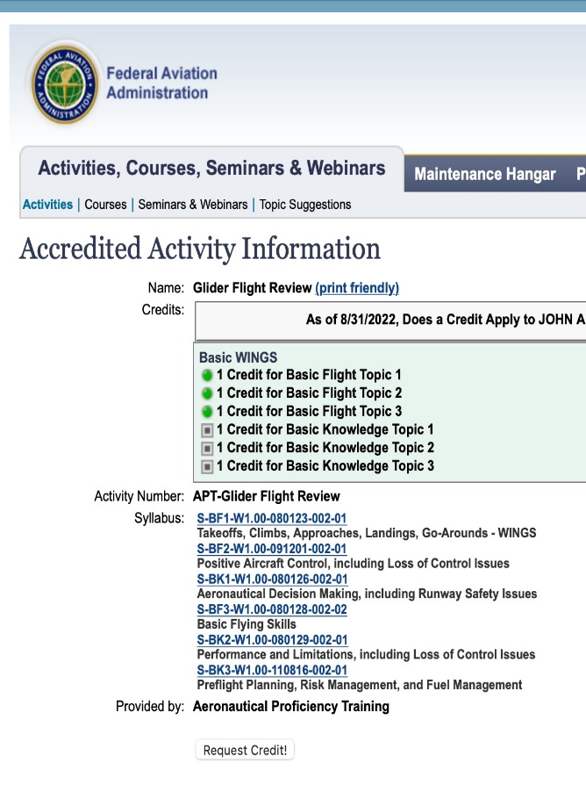
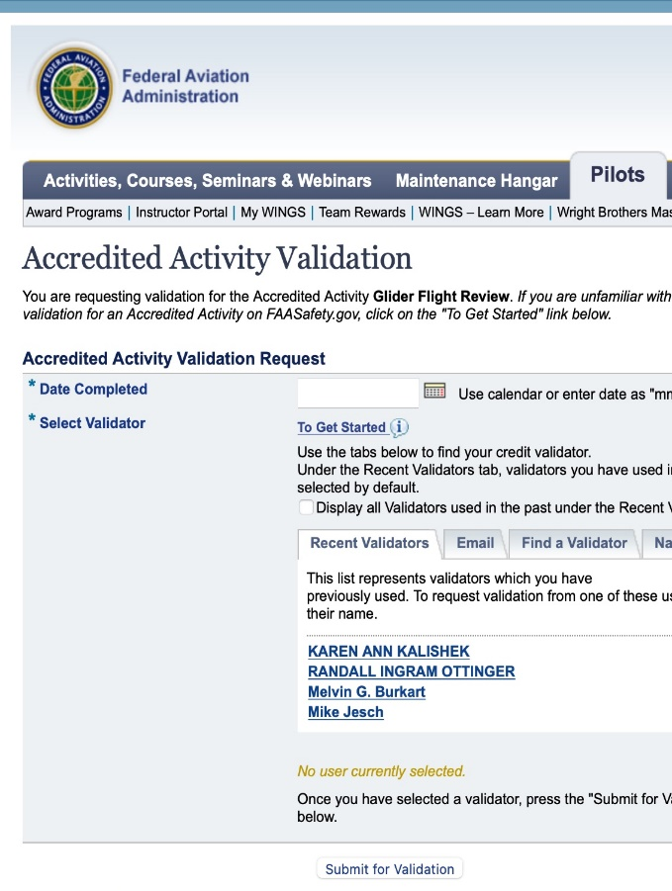
Enter Date
of Activity
Review
Requirements
Select Validator
(your CFI or DPE)
Request
Credit
Submit for
Validation
All Done!
Notes:
You’ll next see a screen that describes the selected activity. Click on Request Credit, then input the date your activity was completed, select a validator, click “Submit for Validation” and you’re done.
(Next Slide)

Slide 20

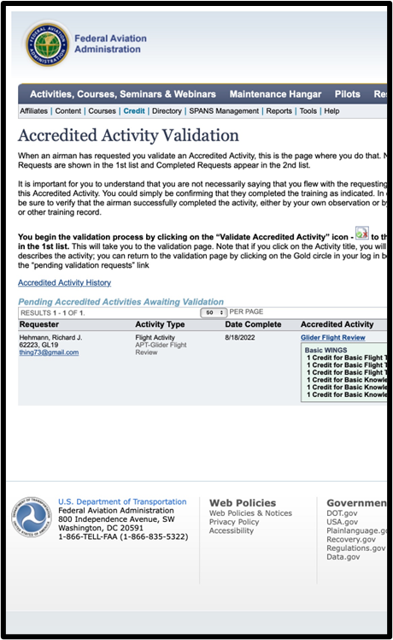
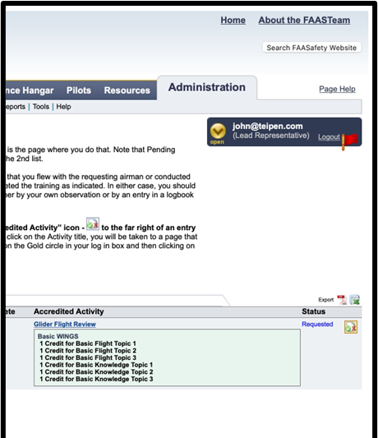
    Validate Requested Credits (for CFIs and DPEs)
Select Validate Requested Credit
Requested Credits Here
Click Logo to Validate
All Done!
Notes:
CFIs and DPEs can use E-Z WINGS too. When they select “Validate Requested Credit” , all credit requests will automatically appear. (Click)
Click on the logotype to validate the request and you’re done. (Click)
Event organizers can also use E-Z WINGS to give credit for event attendance. See your local FPM or WINGSPro for details.
(Next Slide)

Slide 21
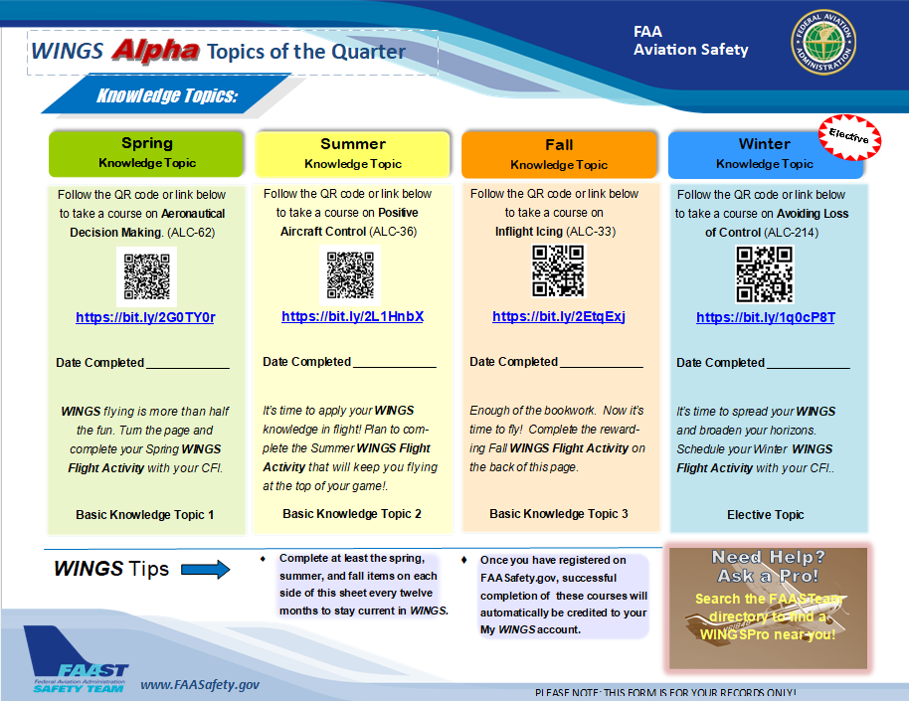
WINGS Topic of the Quarter
On line proficiency courses
  Self-paced
  Do it at home
  Build solid decision making skills on the ground and in the air.
Notes:
Proficiency Training works best if it’s not done all at once, but rather spaced out at regular intervals. The WINGS Topic of the Quarter program consists of eight activities pursued over the course of one year. Because a full year’s proficiency is mapped out for you, It’s an excellent way to get started with WINGS.
Each quarter, WINGS Pilots take an on-line safety course. All courses are self-paced. Most take no more than an hour or two and they can be completed at home. Our online courses build solid decision making skills that you’ll employ on the ground and in the air.
(Next Slide)

Slide 22
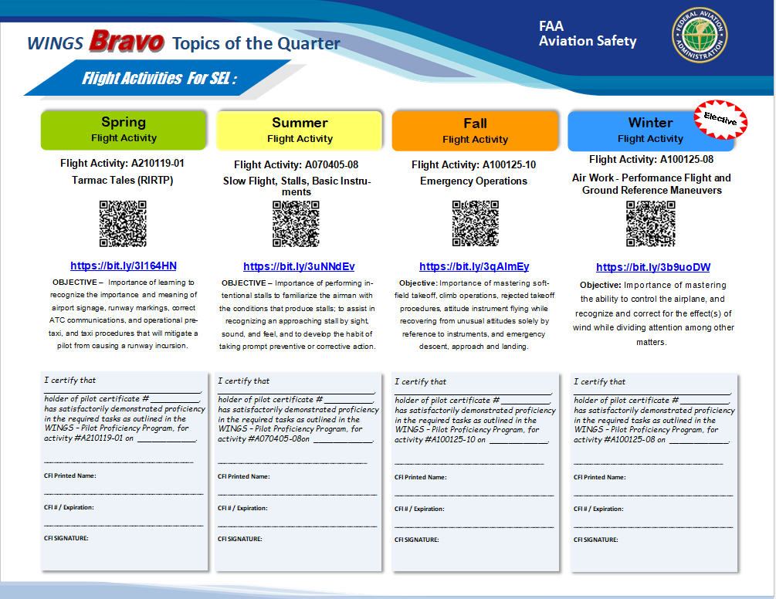
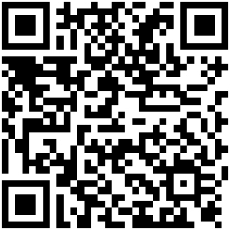
WINGS Topic of the Quarter
Rewarding Flight Activities
  With your CFI
faasafety.gov\resources\library\WINGS
Notes:
Program participants also fly with a Flight Instructor to complete a WINGS Flight Activity at least once each quarter. (Click)
To access WINGS Topic of the Quarter Checklists and other WINGS information just navigate to FAASafety.gov. then click on Resources\Library\WINGS or scan the QR code on screen.
(Next Slide)
Background: You can access the FAASafety.gov library here: https://faasafety.gov/gslac/ALC/lib_categoryview.aspx?categoryId=39

Slide 23

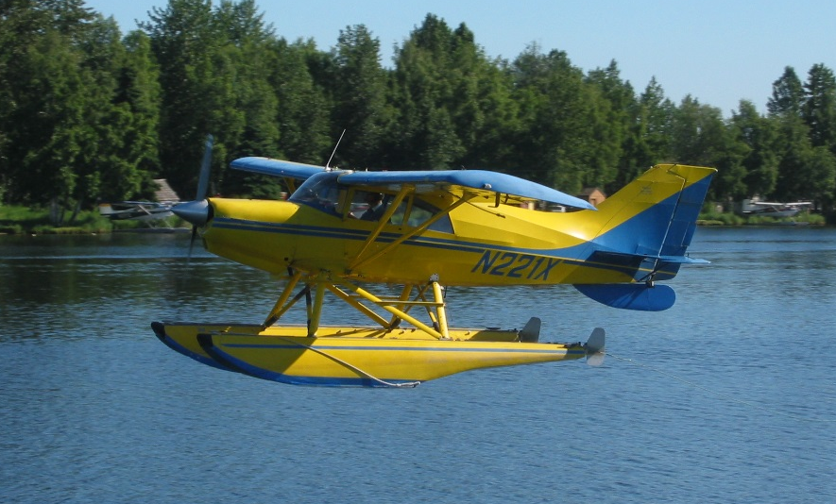

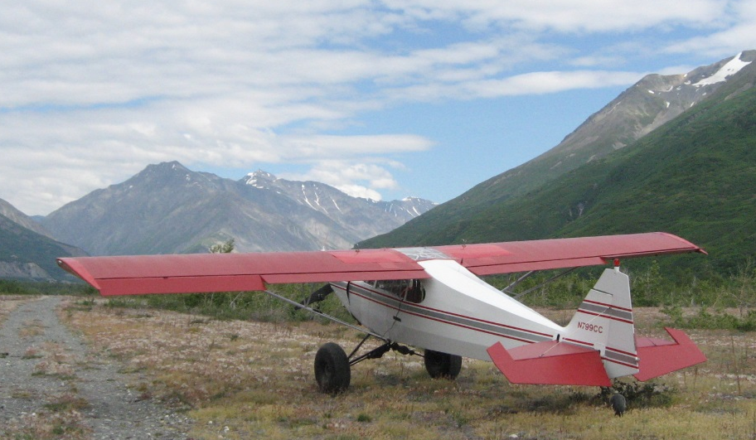
2. WINGS expands your horizons
Notes:
Reason Number 2 – WINGS proficiency training expands your horizons.
Pilots usually think of proficiency training in terms of their usual aviation operations but if you’re willing to expand your horizons there are a host of options that go well beyond the hundred dollar hamburger to make proficiency flying more interesting. Twin engine, turbine, or instrument training can boost capability and confidence in cross country operations. Seaplane and tailwheel training are particularly satisfying for folks who learned in nose wheel airplanes.
And even if you don’t take on the challenges of another rating or airframe, there are many other ways to expand your horizons.
(Next Slide)

Slide 24

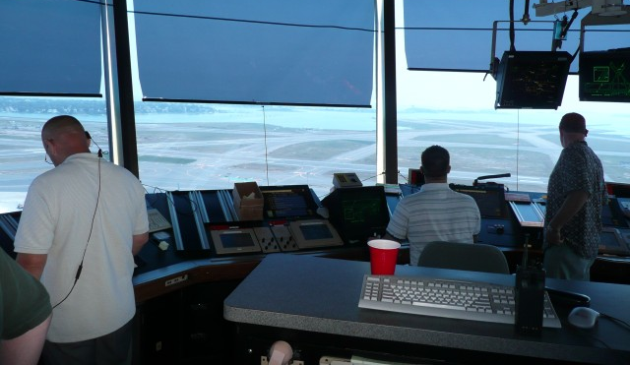
WINGS expands your horizons
Environmental training
Notes:
Training in new operational environments builds confidence too. If you learned to fly at a small country airport you’re probably very comfortable in a non-towered environment. How about a trip to a major metropolitan airport with your flight coach? The traffic and rapid pace of ATC communications can be daunting at first but mastering the environment can be very satisfying.
Likewise, big city pilots who are comfortable with busy towered operations can be overwhelmed when operating to non-towered or back country airstrips. Back country transition training can acquaint you with the nuances of rural environments and ensure your wilderness flying can be done safely.
(Next Slide)

Slide 25
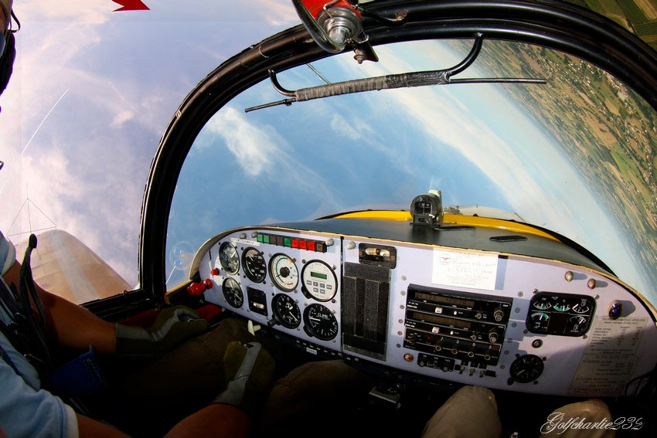
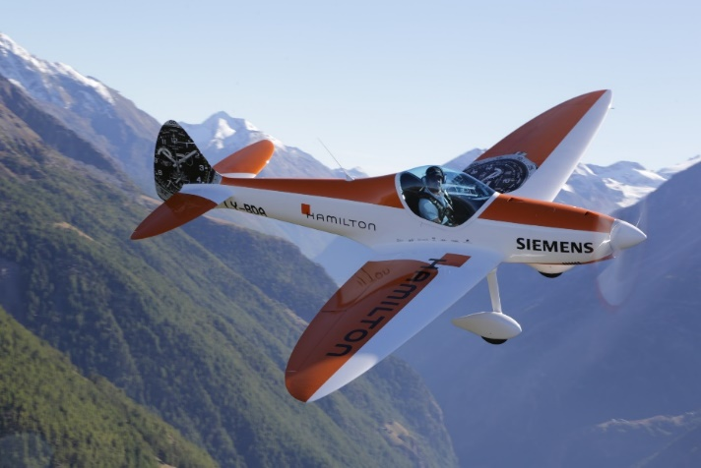
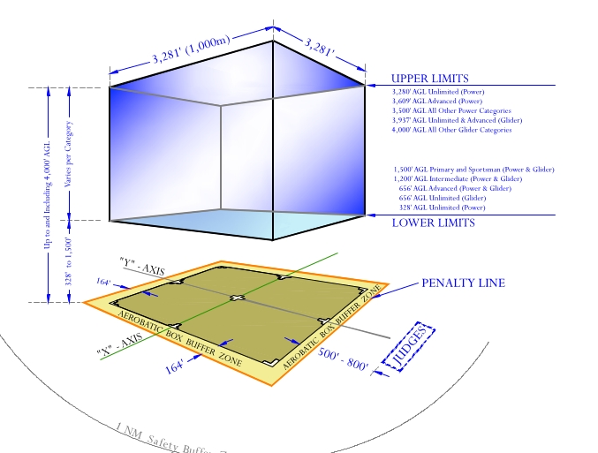
WINGS expands your horizons
Stall/Spin/Aerobatic training
  Slow flight and stall review
  Unusual attitude and Upset Maneuver training
  Spin training
  Basic and advanced aerobatic training
Notes:
A solid review of stalls, slow flight and spins is a great way to prevent loss of control accidents and it’s a natural stepping stone to aerobatic training. Once again WINGS CFIs can coach you to realize your maximum performance potential. Here’s a list of available training to consider:
Begin with a review of stalls and slow flight. This should be done at least annually to maintain peak performance.
Unusual attitude training and review are essential for VFR and Instrument pilots alike. Upset maneuver training includes unusual attitudes but may exceed typical unusual attitude pitch and bank values. Upset maneuver training is common in large airplane operations and includes over and under speed situations.
Spin training begins with incipient spin recognition and prevention and progresses to multiple-turn spins and precision recoveries.
Basic and advanced aerobatic training leverages all of your performance and progresses to competency and comfort in any aircraft attitude.
(Next Slide)

Slide 26
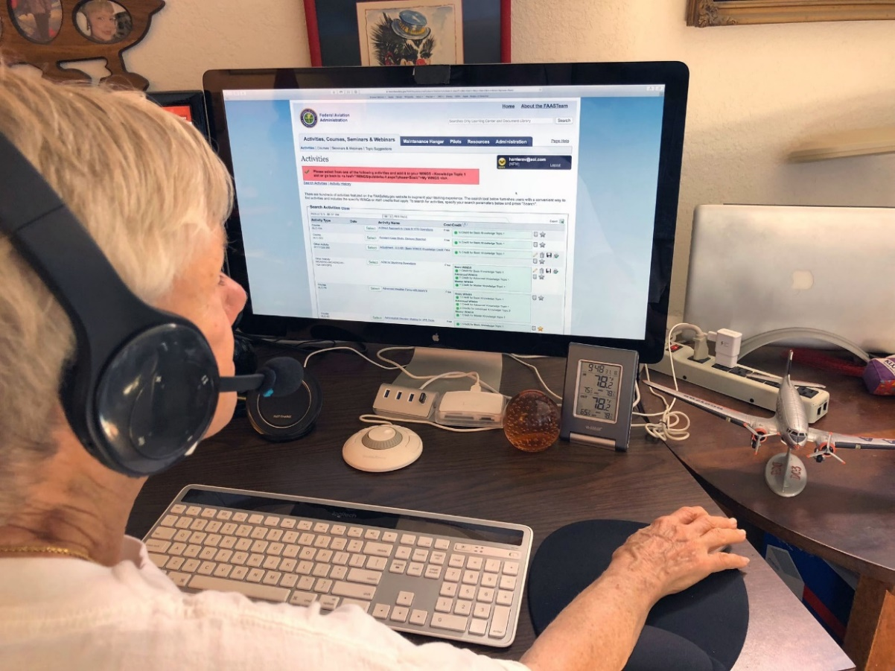
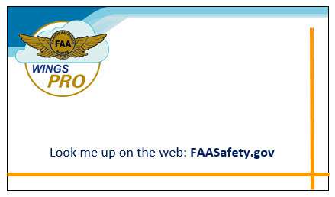
Need help with WINGS?
Contact your local WINGSPro
  Or your FAASTeam Program
  Manager (FPM)
Orville Wright
WINGSPro
Dayton, OH
(927) 003-1217
Notes:
WINGS is a robust proficiency training program that works for all pilot certification levels and all general aviation aircraft. As such, it can be a little intimidating at first. That’s why volunteer WINGSPros in your area are available to help you with anything related to WINGS. Here’s how to find your local WINGSPro(s).
Presentation note: You may want to introduce local WINGSPros in attendance and ask them to present this section. Your WINGSPros can edit the slide text to include their name and contact information.
(Next Slide)

Slide 27
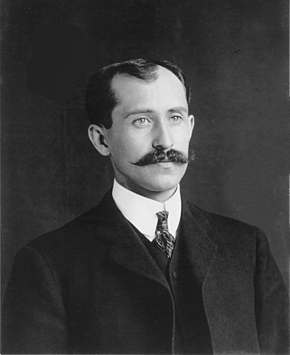
Need help with WINGS?
Contact your local WINGSPro
  Or your FAASTeam Program
  Manager (FPM)
Orville Wright
WINGSPro
Dayton, OH
(927) 121-7903
Notes:
WINGS is a robust proficiency training program that works for all pilot certification levels and all general aviation aircraft. As such, it can be a little intimidating at first. That’s why volunteer WINGSPros in your area are available to help you with anything related to WINGS. Here’s how to find your local WINGSPro(s).
Presentation note: This is hidden. You may want to use it as an alternative to Slide No. 20.
Presentation note: You may want to introduce local WINGSPros in attendance and ask them to present this section. Your WINGSPros can edit the slide to include their name, photo, and contact information.
(Next Slide)

Slide 28
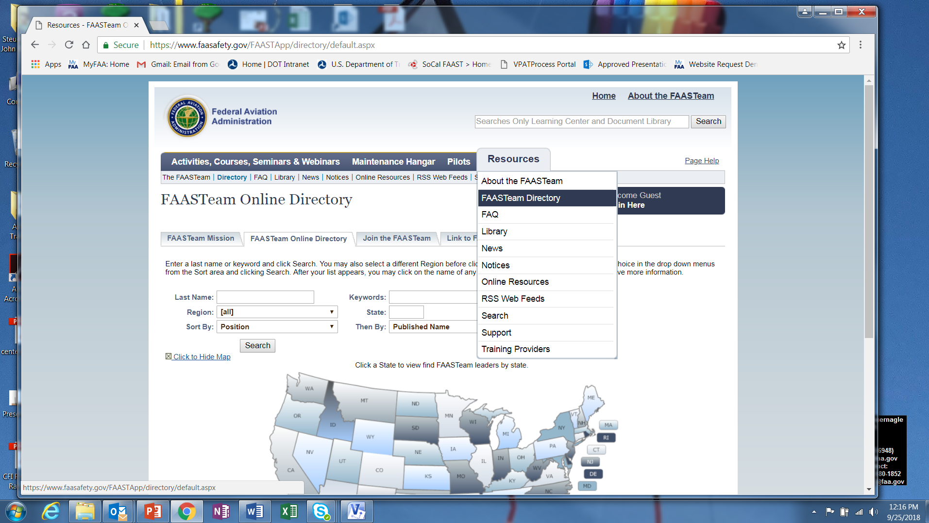
Find your WINGSPro
Notes:
To find your local WINGSPros just navigate to FAASafety.gov. Hover over the resources tab and click on FAASTeam Directory.
(Next Slide)

Slide 29
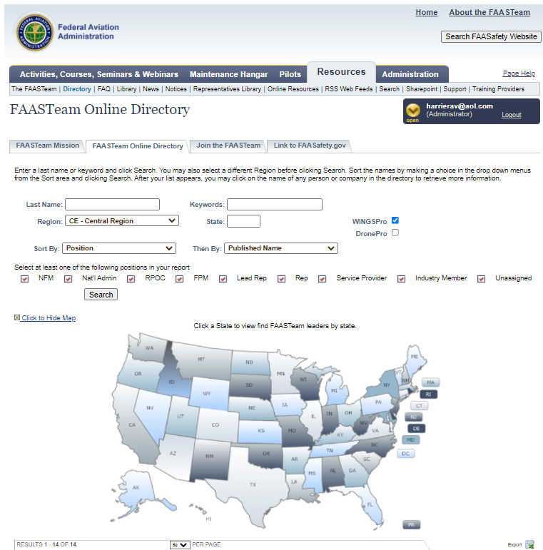
Notes:
Presentation note: This will be more effective if you replace the following illustrations with those that feature local AOR searches and WINGS Pro results.
First select your region and district in this drop down box. (Click)
Next click the WINGSPro box, (Click)
Then click on search. Your WINGSPros will appear in the list below.
(Next Slide)

Slide 30
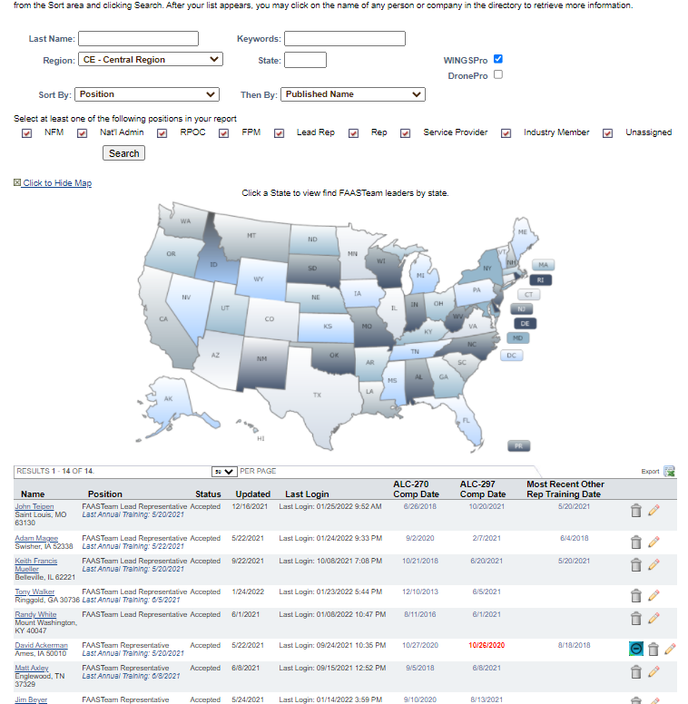
Notes:
Here’s a partial list of WINGS Pros in the Central Region.
(Next Slide)

Slide 31
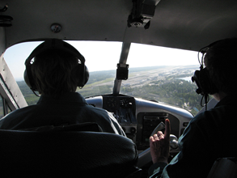
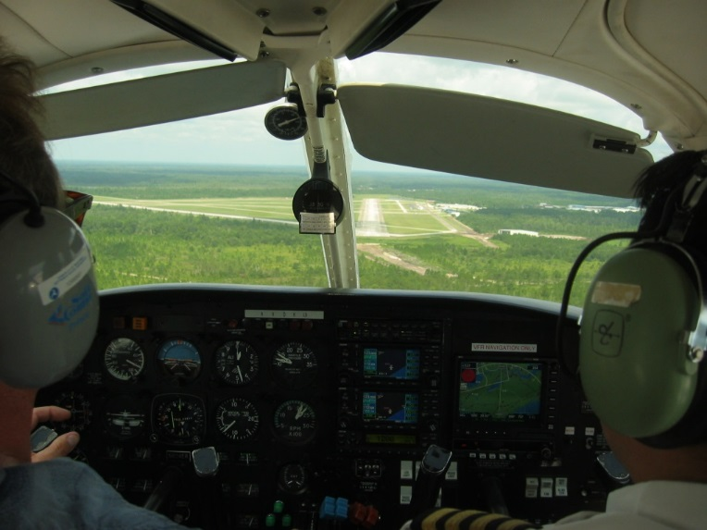
1. WINGS pilots are:
Competent
Confident
Safe
Notes:
Finally, WINGS training yields Proficiency and Peace of Mind. There’s nothing like the feeling you get when you know you’re playing your A game and in order to do that you need good coaching. (Click)
WINGS pilots are Competent. They fly regularly with WINGS CFIs who challenge them to review what they know, explore new horizons, and to always do their best. Vince Lombardi, the famous football coach said, “Practice does not make perfect. Only perfect practice makes perfect”. For pilots that means flying with precision, on course, on altitude, on speed all the time. (Click)
WINGS pilots are Confident. They are well aware of their capabilities and their limitations. They are coached to exercise sound pre and in-flight risk management so they are rarely surprised by unanticipated conditions. Of course they must dedicate time and money to their proficiency programs but it’s well worth it for the peace of mind that comes with confidence. (Click)
And, most importantly; WINGS pilots and their passengers enjoy the benefits of safe flight operations every time they take to the air.
(Next Slide)

Slide 32
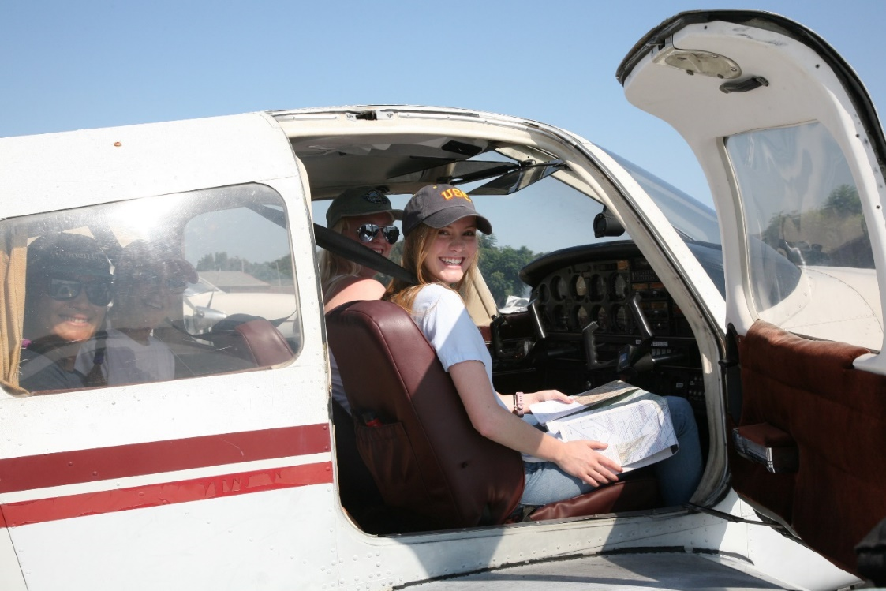
Why WINGS?
WINGS Training yields rewards!
WINGS Proficiency training works!
WINGS coaching gets results!
WINGS broadens your horizons!
1. WINGS pilots are:
  Competent!
  Confident!
  Safe!
Notes:
So here they are again. The top 5 reasons to choose WINGS. Proficiency is key to success in almost every thing worth doing – especially flying. Proficient pilots are competent, confident, and safe.
(Next Slide)

Slide 33

References
FAASafety.gov
  Information and enrollment for WINGS Pilot Proficiency Program
Off Airport Ops Guide
  Baseline performance determination examples
  https://www.faasafety.gov/gslac/ALC/libview_normal.aspx?id=135893
Personal Minimums Development Guide
  https://www.faasafety.gov/gslac/ALC/lib_categoryview.aspx?categoryId=15&r_s=50&r_c=50
WINGS Information and Guidance
  https://faasafety.gov/gslac/ALC/lib_categoryview.aspx?categoryId=39
Notes:
Here are a few references for additional information:
FAASafety.gov is the FAASTeam website where you’ll find a wealth of safety information. You can enroll and track your progress in the FAA WINGS Pilot Proficiency Program here.
Look in the FAASafety.gov library for the Off Airport Operations Guide. In it you’ll find instructions for developing a short field performance baseline together with other useful information on operating to small fields.
Also in the FAASafety.gov Library – the Personal Minimums Development Guide – Your documented proficiency performance can be used to develop minimums that are tailored to you, your aircraft, and your mission.
The Library also contains additional WINGS Information and Guidance
I’ll leave this slide on screen while I take some questions from the audience.
Presentation note: Take questions from the audience while they copy information from the screen. Then:
(Next Slide)

Slide 34

Questions?
Notes:
Presentation Note: You may wish to provide your contact information and main FSDO phone number here. You can also add WINGSPro contact information.
Modify with your information or leave blank.
(Next Slide)

Slide 35
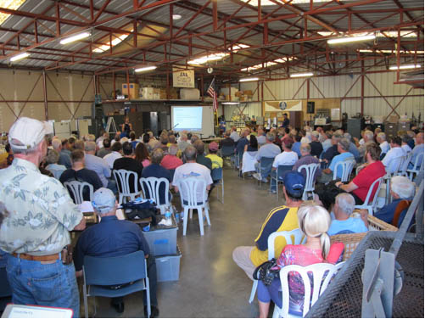

Thank you for attending
You are vital members of our GA safety community
Notes:
Your presence here shows that you are vital members of our General Aviation Safety Community. The high standards you keep and the examples you set are a great credit to you and to GA.
Thank you for attending.
(Next Slide)

Slide 36
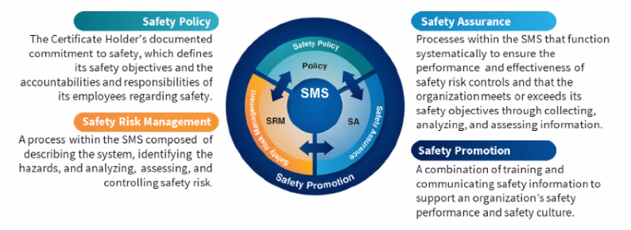
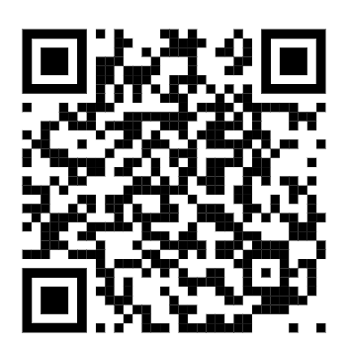
Safety Management Systems (SMS)
Coming to General Aviation
https://www.faa.gov/about/initiatives/gasafetyoutreach
Notes:
Safety Management Systems are a set of policies and processes that can increase the safety and efficiency of any flight operation. And FAA is bringing SMS to General Aviation. You may have heard of SMS but thought it was only for large organizations but actually SMS can be scaled to fit any operation large or small.
There are 4 major components to a Safety Management System (Click)
Safety Policy – a documented commitment to safety that runs from the head of an organization to its newest member. (Click)
Safety Risk Management – a process that identifies hazards within an operation, determines to what extent an identified hazard may impact flight safety, and controls the risk of occurrence to an acceptable level. (Click)
Safety Assurance – By collecting and analyzing information derived from safety performance data Safety Assurance ensures the performance and effectiveness of Safety Risk Controls. (Click)
Safety Promotion communicates safety information and commitment throughout the organization. (Click)
You can find more information about Safety Management Systems at the URL on the Screen.
(Next Slide)

Slide 37
The National FAA Safety Team Presents
Topic of the Month – March
Pilot Proficiency and WINGS
Notes:
(The End)

